Slide 1


The RSGB is supporting
World Space Week 2026!
Take inspiration from our ideas at rsgb.org/wsw and then start planning your event
4-10 October 2026
All slides in this presentation are copyright of the RSGB 2026 and Patrick Wood, 2E0IFB

Slide 2
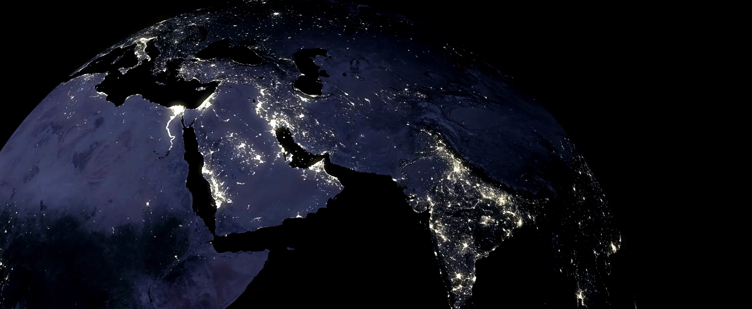
World Space Week 2026

Slide 3
World Space Week 2026
General slides about the Space environment
"Here are a few ideas to help you put together a talk during World Space Week from 4-10 October 2026: pick and choose whatever works for you."

Slide 4
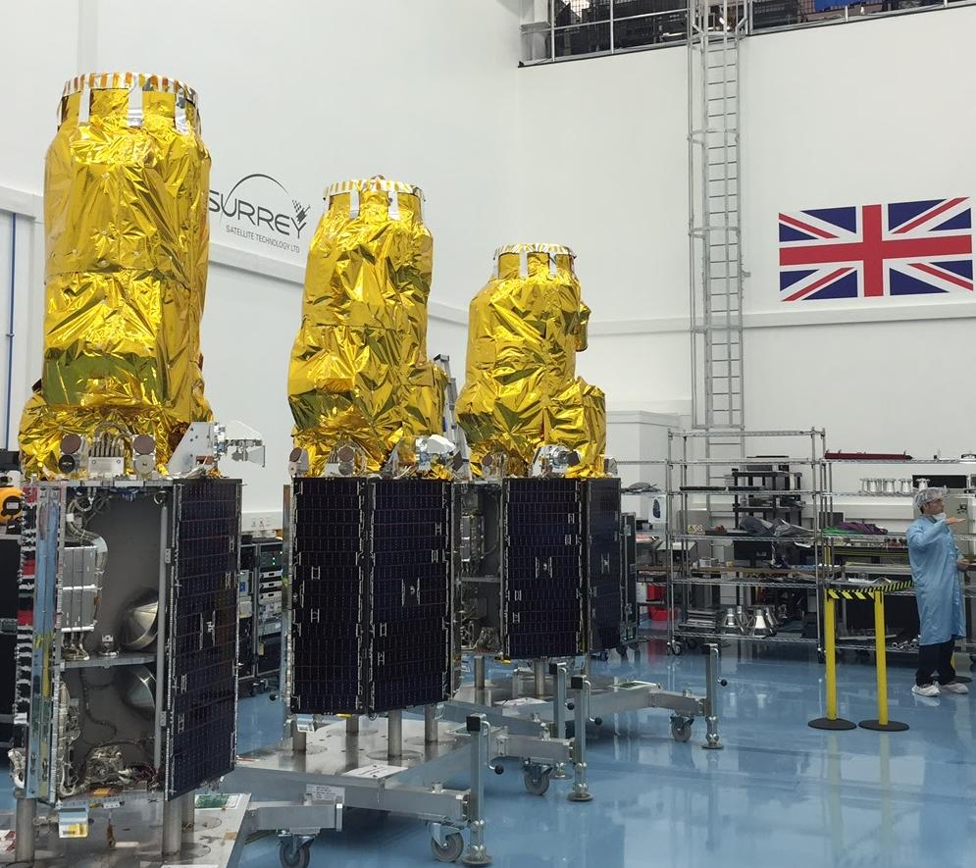
TITLE
Presenter
4
Image © SSTL
Notes:
Title slide - background on the image
THE PICTURE: this is SSTL's DMC3 constellation - three Earth-imaging satellites built in Guildford, Surrey.
THE BASICS
Line to use: "The satellites on this slide were designed and built in Britain, by a company that started life as a university spin-out."
Background: DMC3 stands for Disaster Monitoring Constellation, third generation. Three identical satellites - DMC3-1, 2 and 3, also called TripleSat - launched together on an Indian PSLV rocket in July 2015.
WHAT THEY DO
Line to use: "They take detailed pictures of the Earth's surface - sharp enough to see individual vehicles and buildings."
Background: About 1 metre detail in black and white, 4 metres in colour. They fly in the same orbit, spaced 120 degrees apart, so between them they can photograph anywhere on Earth every day. Each one can also be tilted to point at a target, rather than only looking straight down.
WHY IT MATTERS
Line to use: "The original purpose was helping after disasters - floods, earthquakes, wildfires - by getting fresh images quickly."
Background: The same images are also used for mapping, farming, city planning and environmental monitoring. Earlier DMC satellites were sold to countries such as Algeria, Nigeria and Turkey, giving them their first national spacecraft.
THE LINK TO THIS TALK
SSTL proved that useful satellites can be built small, quickly and at reasonable cost using off-the-shelf electronics - the same thinking that makes amateur-built satellites possible today.

Slide 5
From Sputnik to today
4 October 1957: Sputnik 1 - beeps on 20 and 40MHz, heard by amateurs worldwide
One satellite then; over 16,000 active spacecraft now
Space runs daily life: navigation, comms, weather, disaster response
It changed how we see ourselves - Earthrise, Apollo, Hubble and Webb
Amateur radio grew with it: OSCAR 1 in 1961 to ISS contacts today
But orbits are crowding: debris, collision risk, brighter skies, more interference
The next 70 years: not can we use space, but how we use it responsibly

Slide 6
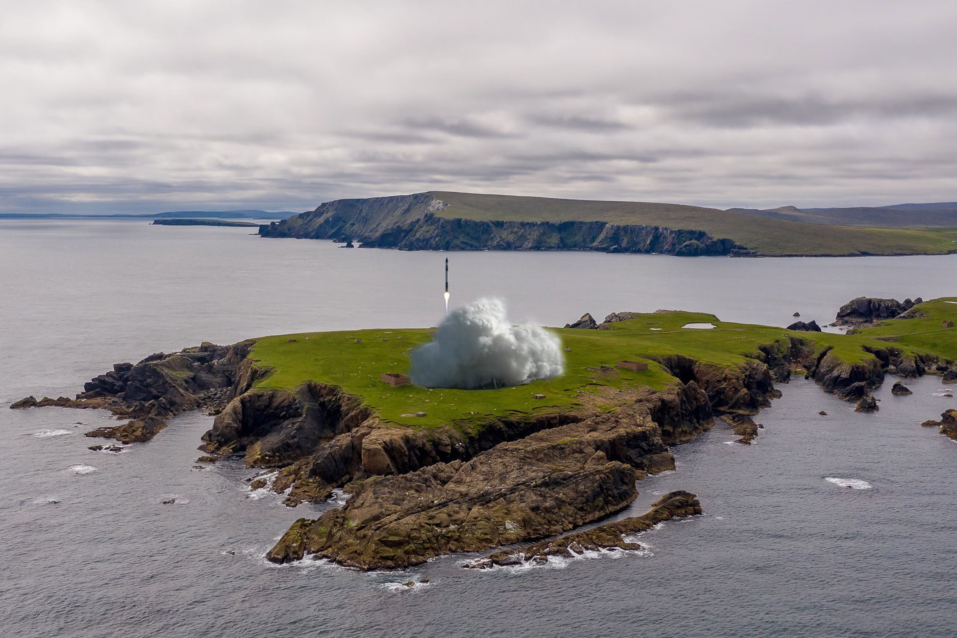
The UK in Space: From Ariel 1 to the Shetland Isles
Six decades from Britain’s first satellite, through a lost launch capability, ESA science missions to world-leading spacecraft manufacturing.
1962
1971
1975–1986
1990s–2020s
2010–today
First satellite
Launch, then retreat
Into Europe
Exploration & industry
Agency and launch
Ariel 1 launched on 26 April 1962 aboard a US Thor-Delta, making Britain the third nation to operate its own satellite.
Prospero reached orbit on 28 October 1971 atop a British Black Arrow rocket — still the only UK satellite launched by a UK rocket. The programme was cancelled as it flew.
A founder member of ESA in 1975. Giotto, built by British Aerospace in Bristol, flew through the coma of Halley’s Comet in March 1986 on Europe’s first deep-space mission.
UK-built hardware carried ESA to Titan on Huygens and to a comet on Rosetta, alongside the UK-led Beagle 2. Airbus Stevenage built Solar Orbiter (2020) and the Rosalind Franklin Mars rover.
The UK Space Agency united civil space in 2010. The first orbital attempt from UK soil fell short at Spaceport Cornwall in 2023; SaxaVord in Shetland is now the UK’s first licensed vertical-launch spaceport.
~25%
of the world’s telecommunications satellites have been designed and built in the UK — Stevenage and Portsmouth supplying GEO platforms and payloads to global operators for two decades.
Sources: ESA, Airbus, UKspace, UK Space Agency
Notes:
UK in Space - speaker notes
WHAT THIS SLIDE IS: a timeline with five steps. Tell one short story per step. The story arc: early success, a lost chance, a fresh start with Europe, great satellite building, and now launching again.
1962 - FIRST SATELLITE
"Britain's first satellite, Ariel 1, went up in 1962. Only the USA and Soviet Union had done this before."
Add: America built the satellite body and launched it. British universities built the science instruments. That teamwork set the pattern for years to come.
1971 - WE LAUNCHED, THEN STOPPED
"In 1971 a British rocket, Black Arrow, put a British satellite called Prospero into orbit. It is still the only time we have done that."
Add: The government had already cancelled the rocket to save money - it was cheaper to buy launches from America. Britain is the only country to build its own launcher and then give it up.
1975-1986 - JOINING EUROPE
"In 1975 Britain helped found the European Space Agency, and UK industry got straight to work."
Add: A UK-built spacecraft called Giotto flew through the gas cloud around Halley's Comet in 1986. It was Europe's first deep-space mission and a big success.
1990s-2020s - EXPLORING AND BUILDING
"Britain stopped launching, but never stopped building - and got very good at it."
Add: UK parts helped land on Saturn's moon Titan and reach a comet. The UK-led Beagle 2 landed on Mars but couldn't open up properly. Airbus in Stevenage built Solar Orbiter, which takes the closest pictures of the Sun ever, and is building a Mars rover.
2010 - TODAY - AGENCY AND LAUNCH
"The UK Space Agency was set up in 2010 to bring everything together.“ UKSA reports to Department for Business, Innovation, Science and Trade
Add: A launch from Cornwall in 2023 failed to reach orbit. The focus is now SaxaVord in Shetland - it is far north, which suits the orbits that Earth-watching satellites need.
THE BIG NUMBER: about a quarter of the world's telecoms satellites were designed and built in the UK.
CLOSING LINE: "Six decades, three phases - pioneer, manufacturer, and maybe soon a launch nation again."

Slide 7
From University Labs to New Space
Where today’s UK capability comes from: academic instrument-building, a landmark spin-out, and a generation of fast-growing companies.
1966–today
1985
2005–2014
2015
Today
University instruments
The SSTL spin-out
Scotland’s cluster
New space at Harwell
Servicing and data
UCL’s Mullard Space Science Laboratory has contributed hardware to over 300 space missions. Leicester, Imperial and The Open University continue to build leading-edge instruments for ESA and NASA.
Surrey Satellite Technology spun out of the University of Surrey in Guildford, pioneering low-cost small satellites. Forty years on it is still building world-leading smallsats and exporting the model.
Clyde Space was founded in Glasgow in 2005 around CubeSat subsystems; its UKube-1 became Scotland’s first satellite in 2014. Now AAC Clyde Space, delivering end-to-end missions and components.
Open Cosmos launched at the Harwell campus in 2015 to simplify access to orbit. It raised $50 million in 2023 and now employs more than 300 people delivering Earth-observation missions.
Astroscale UK demonstrated end-of-life capture with ELSA-d and leads COSMIC, the UK national debris-removal mission. Spire Global builds and operates constellation satellites from Glasgow.
40 yrs
of continuous UK small-satellite manufacture since SSTL spun out of the University of Surrey in 1985 — the university-to-industry model now repeated across Guildford, Glasgow and Harwell.
Sources: UCL MSSL, SSTL, AAC Clyde Space, Open Cosmos, Astroscale, Spire Global
Notes:
From university labs to New Space - simple speaker notes
THE MAIN POINT: Britain's space industry did not come from a big government rocket programme. It grew out of university science departments. Students and researchers built instruments, then started companies, and those companies now employ thousands. This is a story about people and skills.
UNIVERSITY INSTRUMENTS
"A lot of this starts in university labs."
Add: UCL's Mullard Space Science Laboratory, in a country house in Surrey, has put hardware on more than 300 space missions since 1966. Leicester, Imperial College and The Open University still build top-class instruments for European and American missions. That is why Britain does so well in space science.
1985 - SSTL, THE FIRST SPIN-OUT
"In 1985 a team at the University of Surrey had an idea everyone thought was silly - build satellites small, fast and cheap, using ordinary electronics."
Add: The company span out of the university and is called Surrey Satellite and Technology and is globally recognised as one of the leaders in small satellite design and build. SSTL has since built over a hundred satellites and basically started the small-satellite industry. Many satellites shown later in this talk come from that idea.
2005-2014 - SCOTLAND
"Glasgow now builds more very small satellites than any other city in Europe."
Add: Clyde Space started in 2005 making parts for tiny CubeSat satellites. In 2014 UKube-1 became Scotland's first satellite - it even carried an amateur radio payload. The company is now AAC Clyde Space and builds whole missions.
2015 - NEW SPACE AT HARWELL
"Open Cosmos wants to make getting to orbit easy - you say what you need, they do the rest."
Add: Started in 2015 in Oxfordshire, raised $50 million in 2023, now over 300 staff. Harwell was once a nuclear research site and is now a space hub with more than a hundred organisations, including ESA's UK centre.
TODAY - CLEANING UP AND USING THE DATA
"The newest work is tidying up space and making sense of the pictures we get from it."
Add: Astroscale UK at Harwell has shown in orbit that old satellites can be caught and removed - the answer to the space junk problem. A growing group of companies turn satellite images into useful information for business and the environment.
CLOSING LINE: "Every one of these companies began with a few people solving one problem, usually at a university." Good message for a general audience, and especially for younger people - there is a clear way in and not enough skilled people to fill the jobs.

Slide 8

Astra Carta: The King’s Charter for Space Sustainability
A Sustainable Markets Initiative framework, founded by HM King Charles III, extending Earth’s sustainability principles into orbit.
2021–2022
28 June 2023
Today
Next
The spark
The launch
From pledge to practice
The road ahead
Orbital crowding and debris put space on the sustainability agenda. Echoing his Terra Carta for Earth, the then Prince of Wales called for an “Astra Carta” at the 2022 Space Sustainability Summit in London.
The King unveiled the Astra Carta seal — designed by Sir Jony Ive — at a Buckingham Palace reception for astronauts, executives, scientists and environmentalists, as the SMI launched the framework.
A voluntary roadmap now carried by SMI Astra Carta Ambassadors and industry. Astroscale’s ELSA-M debris-removal satellite bears the seal, shown to The King at the SMI Roundtables in March 2026.
Wider private-sector adoption, and alignment with the Artemis Accords and national policy such as the UK Plan for Space Sustainability — moving shared norms from ambition to standard practice.
“We now recognise we have a duty to protect the oceans. We must also accept that we have a duty to protect the wider cosmos.”
HM King Charles III, Space Sustainability Summit, 2022
Notes:
Astra Carta - speaker notes
THE MAIN POINT: Astra Carta is a voluntary agreement, set up by King Charles III, that asks the space industry to look after orbit the same way we try to look after the Earth. Nobody is forced to sign it - the idea is that companies agree good behaviour between themselves before the rules catch up.
WHY IT APPEARED
Line to use: "By about 2022, thousands of new satellites were going up, junk was building up, and dodging collisions had become routine."
Background: The King had already created the Terra Carta in 2021, asking businesses to put nature and people first. Astra Carta is the same idea, but for space. He called for it at a space sustainability summit in London in 2022.
JUNE 2023 - THE LAUNCH
Line to use: "It was launched at Buckingham Palace in June 2023, in front of astronauts, scientists and industry bosses."
Background: The King unveiled the Astra Carta seal, designed by Sir Jony Ive - the man behind Apple's products. The seal gives companies something visible to sign up to, which matters in an industry where reputation with governments and investors is worth a lot.
DOES IT ACTUALLY DO ANYTHING?
Line to use: "It is voluntary, so it works by persuading rather than forcing - but it is being used."
Background: Astroscale's ELSA-M spacecraft, built to remove space junk, carries the seal and was shown to The King in March 2026. A group of Astra Carta Ambassadors takes the idea into companies and boardrooms.
WHAT COMES NEXT
Line to use: "The aim is to make good behaviour in orbit normal, not special."
Background: More companies are expected to sign up, and it lines up with other agreements such as the Artemis Accords for the Moon and the UK's own space sustainability plan. Building a satellite that brings itself back down should become as ordinary as fitting seatbelts in a car.
HOW TO PITCH IT
Keep it positive. The comparison that works with any audience: on Earth we treated shared resources as free and endless, and got it wrong. In orbit we have spotted the problem early. Britain is well placed here - the regulator, the junk-removal companies and the charter itself are all based in the UK.
IF THE AUDIENCE INCLUDES AMATEUR SATELLITE BUILDERS
This affects them too. A licence now expects a believable plan for bringing the satellite back down, and low orbits that clear themselves within a few years help with that. Looking after orbit is not just a job for the big operators.

Slide 9
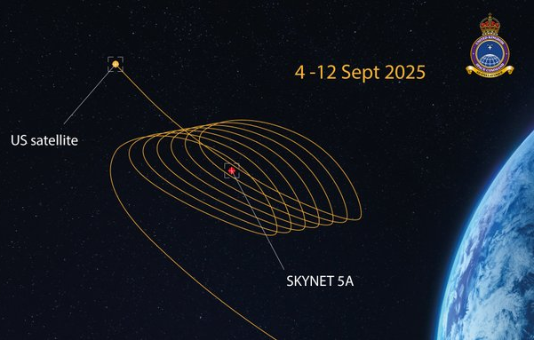
Space: challenges or opportunities
UK Space Command.
Britain must be prepared to defend and control space.
Congested, Contested, Constrained, Competitive and Critical
Global responsibility. Threat environment. National actors
A day without space!
  Space is critical to our economy, 1 day without space could cost up to £20bn
Increased Space Domain Awareness and Space Situational Awareness essential
Rising de-orbiting rate of LEO satellites potential impact on atmosphere unknown
Image – © UK Space Command, 2025
Notes:
Space: challenges or opportunities - speaker notes
THE MAIN POINT: Everything we have looked at so far - crowded orbits, space junk, new rockets - can be seen as a problem or as an opportunity. Both are true, and that is the point of the question in the title.
THE FIVE Cs (UK Space Command's words for space today)
Line to use: "Space Command describes space as congested, contested, constrained, competitive and critical."
Background, one at a time:
- Congested: tens of thousands of tracked objects and thousands of working satellites sharing the same space.
- Contested: space is now treated as a military domain - satellites get jammed and interfered with.
- Constrained: there is only so much room in orbit and only so much radio spectrum. (For a radio audience: it is band planning, on a planetary scale.)
- Competitive: companies now launch more than governments do.
- Critical: which leads to the next point.
A DAY WITHOUT SPACE
Line to use: "Losing satellites for just one day could cost the UK up to £20 billion."
Background: It is not just TV. Satellite timing signals keep banks, mobile networks and the power grid running. Ships, planes and farms rely on satellite positioning. Weather forecasts come from satellites. Most people have no idea. Ask the audience how long they think it would take to notice - the answer is usually minutes.
KNOWING WHAT IS UP THERE
Line to use: "If space is crowded and contested, you have to know what is up there and what it is doing."
Background: This is called Space Domain Awareness - radars, telescopes and countries sharing data to spot near misses. A lot of UK money is going into it, and amateurs genuinely help by tracking satellites and reporting what they hear.
A NEW UNKNOWN
Line to use: "We now burn up old satellites on purpose - possibly several a day - and nobody knows what that does to the atmosphere."
Background: Burning satellites release metals, mainly aluminium, high in the atmosphere. Scientists are still researching the effect on the ozone layer. A good example of solving one problem and creating another.
SHARED RESPONSIBILITY
Nobody owns orbit. It only works if countries and companies cooperate on junk, radio spectrum and traffic rules. That cooperation exists, but it needs to get stronger.
HOW TO CLOSE
Finish on opportunity, not fear. Every challenge here is somebody's job: tracking, repairing, clean-up, regulation, science and engineering. Amateur radio is part of it - we listen, track, build and fly payloads.
Image credit: UK Space Command, 2025.

Slide 10
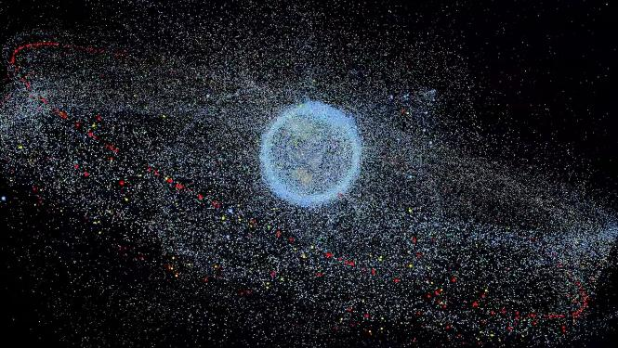
Space Objects / Debris
May 2024: satellite tracking website “Orbiting Now” lists 9,900 active satellites in various Earth orbits
  Closer to 12,000 in 2025
In the three main Earth orbits
  GEO 12% (large satellites dominate)
  MEO 3%
  LEO 84% (small satellites dominate) 2025 > 93%
After 70 years, space debris estimate?
  Larger than 10 cm: ~ 36,500 objects / debris
  Between 1–10 cm: ~ 1 million pieces
  Between 1 mm–1 cm: ~ 130 million pieces
What are the consequences of space debris?
Space debris can travel faster than a bullet
Over the next 10 years, space debris is likely to grow by a factor of 3
How can we reduce space debris?
Remove satellites from orbit within 25 years of end of mission
Remove dead satellites from orbit
Use nets, magnets, lasers, or harpoons to grab satellites
Wait for smaller pieces of debris to re-enter Earth's atmosphere
© ESA
Notes:
Space debris - speaker notes
THE MAIN POINT: Almost everything we have ever launched is still up there in some form, and it is moving very fast. That is a problem, but it is also creating a whole new industry.
HOW DANGEROUS IS IT?
Line to use: "Space junk travels at about 7.5 km a second - roughly ten times faster than a rifle bullet."
Background: At that speed a fleck of paint hits like a hammer and a bolt hits like a grenade. It is the speed, not the size, that does the damage.
THE NUMBERS ON THE SLIDE
Line to use: "After about seventy years of spaceflight, there are around 36,500 pieces bigger than 10cm, a million between 1 and 10cm, and about 130 million tiny fragments."
Background: Only the biggest ones can be tracked; the rest we simply cannot see. Working satellites went from about 9,900 in 2024 to around 12,000 in 2025, and over 90% of them are in low orbit.
WHERE IT COMES FROM
Line to use: "Most of it comes from old rocket stages, dead satellites and two big events."
Background: China destroyed one of its own satellites in a 2007 weapons test, and in 2009 a dead Russian satellite crashed into a working American one. Between them they created thousands of pieces still in orbit.
THE WORRY
Line to use: "The fear is a chain reaction - crashes making debris, which causes more crashes."
Background: This is called the Kessler Syndrome. It is not a Hollywood explosion; it is certain orbits quietly becoming too risky to use for decades. The Space Station has to move out of the way several times a year.
WHAT IS BEING DONE
Line to use: "The rules are tightening and the clean-up technology already exists."
Background: Satellites must now come back down at end of life - the old 25-year rule is being cut to about five. Old rocket stages are emptied of fuel so they cannot explode. Companies are testing nets, harpoons, magnets and robot arms - Astroscale, which has a big UK operation, has already demonstrated this in orbit.
THE OPPORTUNITY
The mess is also a business: repairing, refuelling, inspecting and removing satellites, plus tracking everything and warning operators. Britain is strong in both tracking and removal.
FOR AN AMATEUR AUDIENCE
Amateur satellites face the same rules, which is why most fly low enough to come back down naturally within a few years. Amateurs also help by tracking and reporting satellites long after their owners stop listening.
TONE: A light line that works - "we have treated orbit like a motorway lay-by for seventy years and just realised nobody empties the bins." But end positively: the rules are improving and the clean-up has started.
Image credit: ESA.

Slide 11
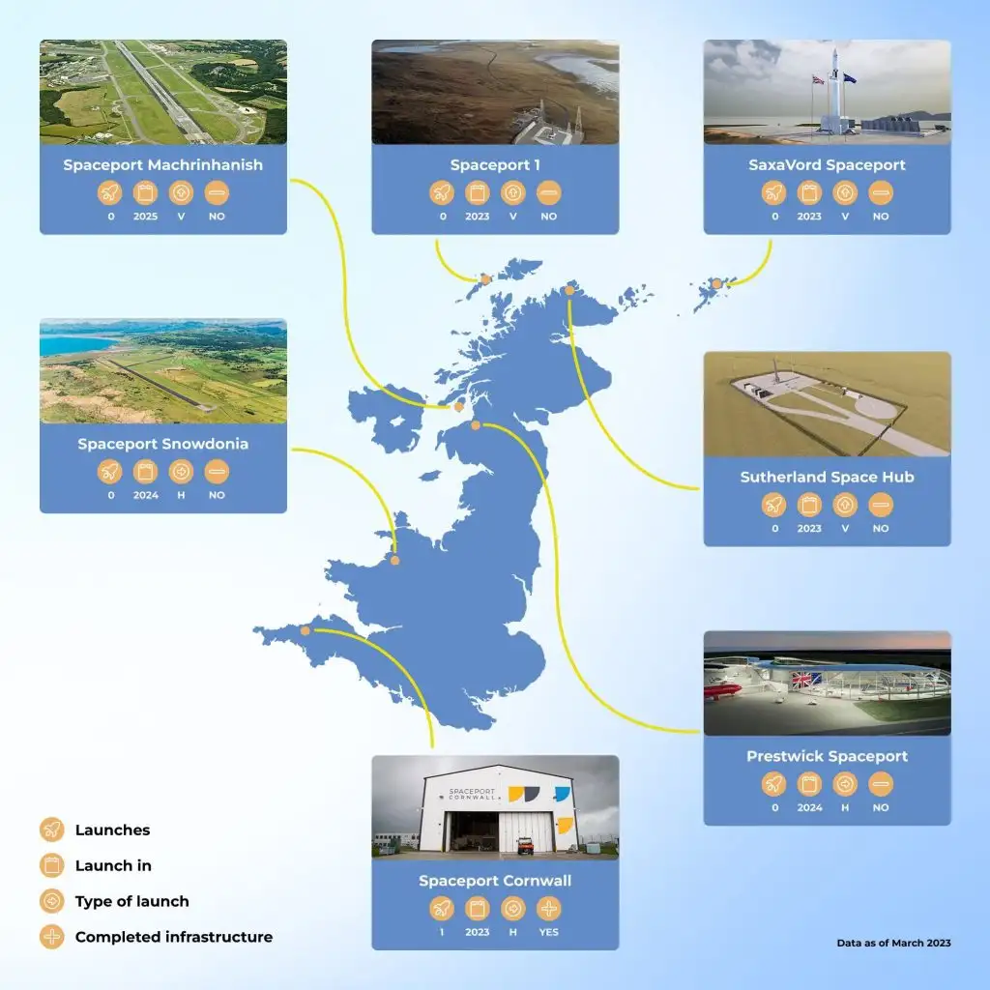
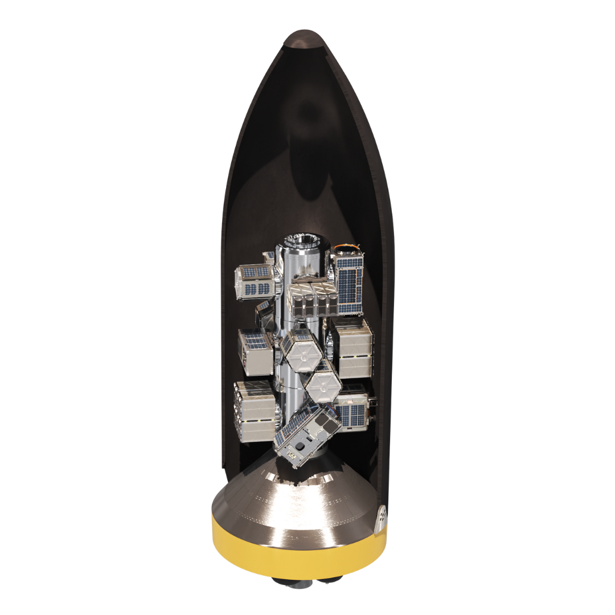
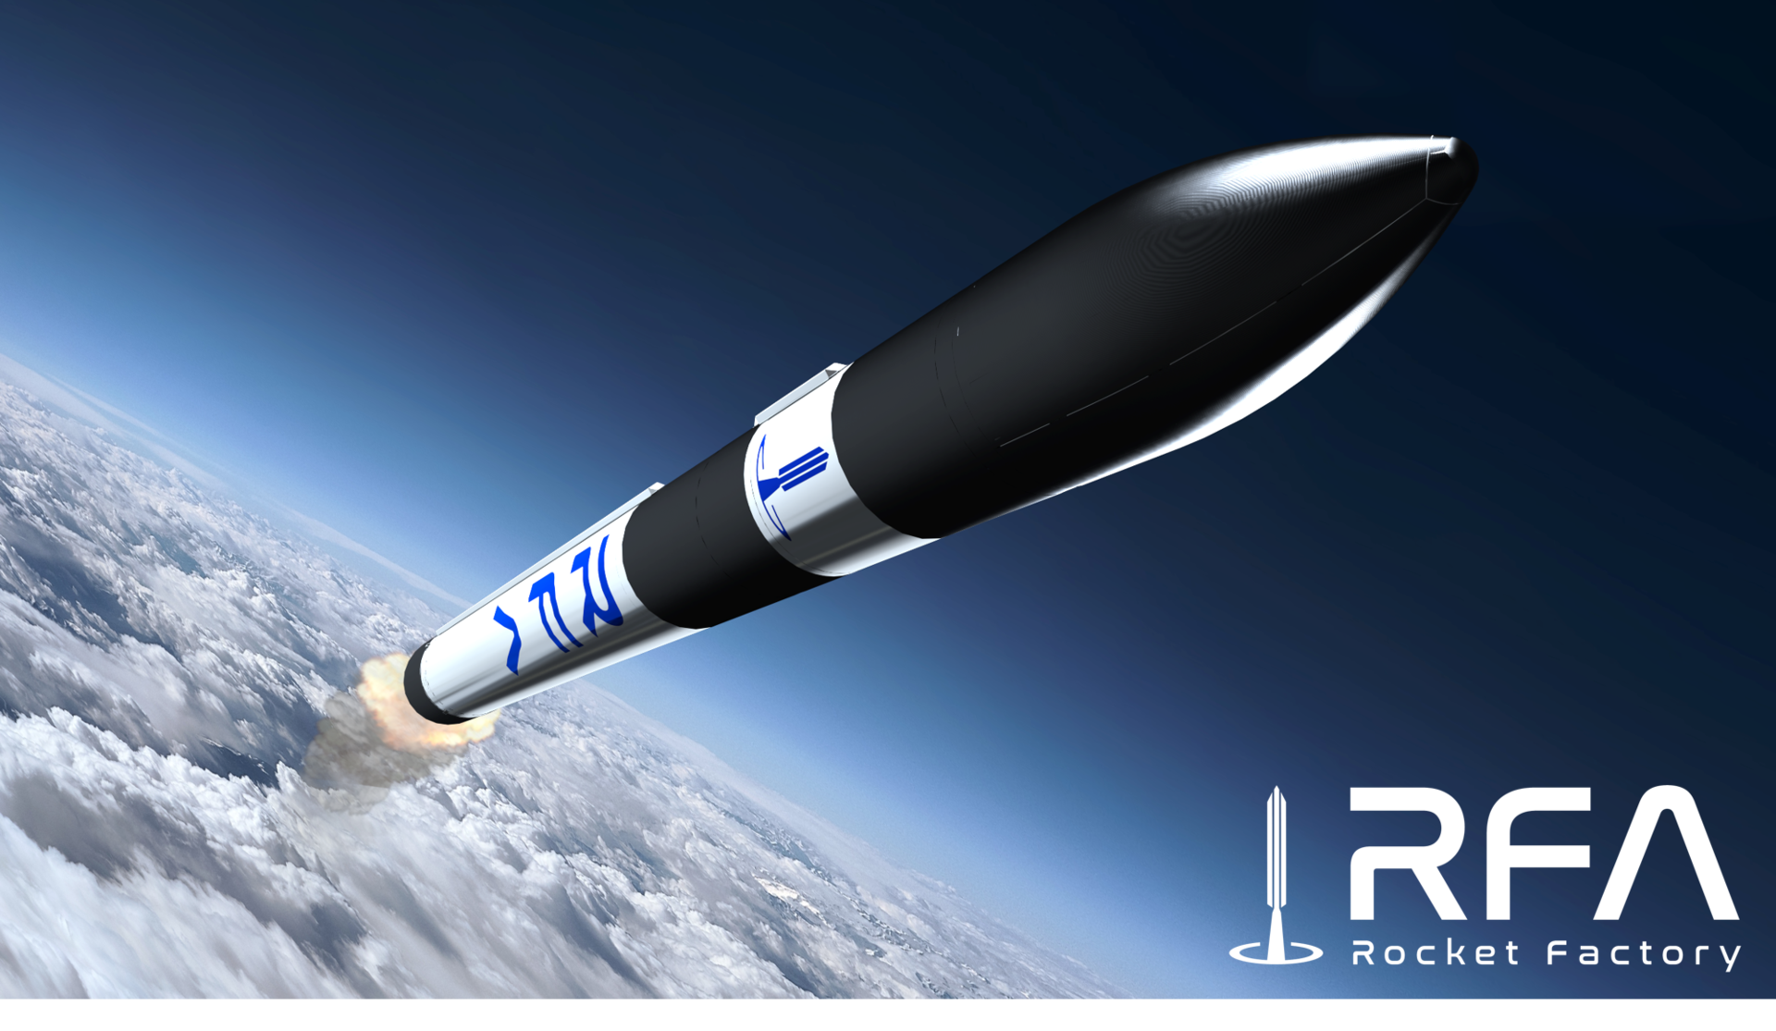
Today: UK and Small Launch Vehicles
Rocket Factory Augsburg AG, potentially 1st Launch from Saxa Vord
RFA ONE
1300kg to 500 km SSO
850kg to 2000 km Polar Orbit
150kg to GEO
202x?
202x?
2025?
Licenced
Payloads upto 1300kg
© ESA/RFA
RFA founded in 2018, spin out from OHB
RFA awarded UK licence (Jan 25 for debut launch in 2025)
German micro launcher. First European launch licence outside ESA site in Kourou
Other vertical launcher companies working towards UK launch
  - Orbex (ceased trading)
  - Skyrora
SaxaVord Spaceport plans up to 30 launches per year.
Also looking at plans to support GEO launches.
RFA plan one launch per week
202x facilities?
Paused
Payloads upto 500kg
2025?
© OrbitalToday
Future Air & Space
Notes:
UK launch - from Black Arrow to SaxaVord - speaker notes
THE MAIN POINT: Britain launched a satellite on its own rocket once, in 1971, then gave it up. Fifty years on we are trying again - this time with private companies rather than a government programme.
THE HISTORY, BRIEFLY
Line to use: "Britain reached orbit in 1971 and then walked away from it."
Background: Black Arrow launched the Prospero satellite from Australia in October 1971, making Britain the sixth country to launch its own satellite. The programme had already been cancelled three months earlier to save money - ministers thought it was cheaper to buy launches from America. We are the only country ever to build a launcher and then abandon it. The last unused rocket is in the Science Museum.
THE GAP, AND THE RESTART
Line to use: "We kept building satellites, but they all flew on somebody else's rocket."
Background: In 2014 the government decided to build a UK spaceport. Small satellites had created a real market, and Britain's far north is well placed for the polar orbits that Earth-watching satellites need. A 2018 law set up the rules, with the Civil Aviation Authority as regulator.
THE SPACEPORTS
Line to use: "There were once seven or eight proposed spaceports. Realistically it is now two."
Background: SaxaVord in Shetland holds the UK's first vertical launch licence and has permission for up to 30 launches a year. Spaceport Cornwall is licensed but has no rocket company. Sutherland in Scotland has been mothballed.
THE CORNWALL ATTEMPT, 2023
Line to use: "The first launch attempt from British soil came within a whisker of working."
Background: In January 2023 a converted jumbo jet took off from Newquay and released a rocket at 35,000 feet. The plane worked perfectly; the rocket's second stage failed and nine satellites were lost. The company, Virgin Orbit, went bust weeks later.
WHAT HAPPENS NEXT - RFA
Line to use: "The likely first launch from the UK is a German rocket called RFA One, from Shetland."
Background: Rocket Factory Augsburg was founded in 2018. Its rocket can carry about 1,300kg to a 500km orbit. It got its UK licence in January 2025 - the first European launch licence outside the ESA site in French Guiana. It has had setbacks: a first stage was destroyed in a ground test at SaxaVord in 2024.
THE OTHERS
Skyrora in Edinburgh is developing its own small rocket. Orbex has ceased trading. Building rockets costs far more and takes far longer than anyone expects - companies failing is normal worldwide, not just here.
HONEST SUMMARY: We have licensed spaceports, a licensed rocket and real hardware being tested - but nothing has yet reached orbit from the UK. The first one will be historic. Check the latest news before presenting; dates slip often.
Image credits: OrbitalToday; ESA/RFA.

Slide 12
LEO Satellite Constellations, the first 50 years ~150 LEO Sats
MEO Satellites up to Galileo & O3b ~ 140 MEO Sats ~90 Nav related
Name / Company / Project | Country / Consortium | Status | First Launch / Announcement | Number of Satellites (Active / Planned) | Orbital Height (km) | Application / Notes
Transit (US Navy) | USA | Retired | 1960 | 5 active (historical) | ~1,100 | Navigation
TIROS (NASA) | USA | Retired | 1960 | 10+ (historical) | ~700–900 | Weather
GPS (Navstar) | USA | Operational | 1978 | 31 active / 32 planned | ~20,200 (MEO) | Navigation, global
GLONASS | Russia | Operational | 1982 | 24 active / 27 planned | ~19,100 (MEO) | Navigation, global
BeiDou | China | Operational | 2000 | 35 active / 35 planned | ~21,500 (MEO), some GEO/LEO | Navigation, global
Orbcomm | USA | Operational | 1995 | 31 active / 35 launched | ~825 | IoT/M2M
Iridium | USA | Operational | 1997 | 66 active / 95 launched | ~780 | Voice/data
Celestri (Motorola) | USA | Cancelled | 1997 (planned) | 0 active / 63 planned | ~1,400 (planned) | Broadband, cancelled
SkyBridge (Alcatel) | France | Cancelled | 1997 (planned) | 0 active / 80 planned | ~1,500 (planned) | Broadband, cancelled
Teledesic | USA | Cancelled | 1998 (planned) | 0 active / 288 planned (orig 840) | ~1,350 (planned) | Broadband, cancelled early 2000s
Globalstar | USA | Operational | 1998 | 48 active / 52 launched | ~1,400 | Voice/data
AprizeSat (SpaceQuest) | USA | Operational | 2002 | 12 active / 12 planned | ~700 | IoT/M2M
SaudiComsat | Saudi Arabia | Operational | 2004 | 7 active / 24 planned | ~700 | IoT/M2M
Galileo | European Union | Operational | 2011 | 28 active / 30 planned | ~23,222 (MEO) | Navigation, global
Spire Global | USA/UK/Singapore | Operational | 2012 | 100+ active | ~500–650 | Earth obs/IoT
O3b (SES) | Luxembourg | Operational | 2013 | 20 active / 20 planned | ~8,062 (MEO, not LEO) | Broadband (MEO)
Planet Labs | USA | Operational | 2013 | 200+ active | ~475–500 | Earth observation
LeoSat | Netherlands | Cancelled | 2013 (planned) | 0 active / 78 planned | ~1,400 (planned) | Broadband, project paused
Notes:
Constellations - the first 50 years - speaker notes
THE MAIN POINT: For the first fifty years of the space age, only about 150 satellites were part of a "constellation". Today one company can launch that many in a couple of months. That contrast is the whole slide.
WHAT A CONSTELLATION IS
Line to use: "One satellite can only cover the patch of Earth it is over. A constellation is a group flying together so one is always in view."
Background: It is what makes satnav, global messaging and daily imaging of the planet possible.
THE PIONEERS - 1960s AND 70s
Line to use: "It starts in 1960 with two American systems: Transit, which let submarines work out where they were, and TIROS, the first weather satellites."
Background: GPS followed from 1978 and the Russian GLONASS from 1982. Navigation satellites sit high up, around 20,000km, where a couple of dozen can cover the whole planet.
THE 1990s BOOM AND BUST
Line to use: "Look at how many of these were cancelled - roughly as many as ever flew."
Background: Iridium, Globalstar and Orbcomm made it and are still flying. Celestri (63 satellites), SkyBridge (80) and Teledesic - Bill Gates' project, originally 840 satellites - never flew at all. Even Iridium went bankrupt in 1999. The technology worked; the business case did not, because mobile phone networks spread faster than expected.
WHY THAT MATTERS
Building satellites was never the hard part. Paying for hundreds of launches before you have a single customer is. The same pattern still repeats today.
NAVIGATION GOES GLOBAL
China's BeiDou from 2000 and Europe's Galileo from 2011 mean there are now four independent global satnav systems.
THE SMALL SATELLITE REVOLUTION
Line to use: "From about 2012 everything changes - make them small and cheap, and you can fly hundreds."
Background: Spire has over 100 satellites, Planet Labs over 200. Planet photographs the entire land surface of the Earth every single day.
HOW TO USE THE TABLE
Do not read it out. Pick three rows and tell three stories: Transit in 1960 as the grandfather of satnav, Teledesic as the great might-have-been, and Planet Labs as the moment small satellites changed everything. Then let the audience scan the status column and notice how often it says "cancelled".
AMATEUR ANGLE: Amateur radio has had its own constellation all along - OSCAR satellites since 1961, built by volunteers. We were doing small and cheap decades before it became a business.

Slide 13
LEO Satellite Constellations, 2010 onwards ~7300 satellites
Name / Company / Project | Country / Consortium | Status | First Launch / Announcement | Number of Satellites (Active / Planned) | Orbital Height (km) | Application / Notes
Satellogic | Argentina | Operational | 2016 | 30+ active | ~475–500 | Earth observation
OneWeb | UK/France | Operational | 2019 | ~632 active / 648 planned | ~1,200 | Broadband
Starlink (SpaceX) | USA | Operational | 2019 | ~5,800 active / up to 42,000 planned | ~550 (main shell), 340–1,325 | Broadband
Tianqi (GuoDianGaoKe) | China | Operational | 2018 | 37 active / expanding | ~500–600 | IoT
BlackSky | USA | Operational | 2018 | 16 active / 60 planned | ~430–450 | Earth observation
ICEYE | Finland | Operational | 2018 | 20+ active | ~500–600 | SAR/Earth obs
Swarm Technologies | USA | Operational | 2018 | 120+ active | ~550 | IoT
Hiber Global | Netherlands | Operational | 2018 | 48 active / 48 planned | ~600 | IoT
Astrocast | Switzerland | Operational | 2018 | 18 active / 100 planned | ~550 | IoT
Kepler Communications | Canada | Operational | 2018 | ~21 active / 140 planned | ~575 | IoT/data services
Guowang (China SatNet) | China | Deploying | 2022 | ~100 active / 13,000 planned | ~1,100–1,200 (planned) | Broadband, dual-use
Geely (Future Mobility) | China | Deploying | 2022 | 30 active / 72 (phase 1), 264 (phase 2), 5,676 (final) | ~600–800 | Vehicle IoT
Amazon Kuiper | USA | Deploying | 2023 | 2 active / 3,236 planned | 590, 610, 630 (three shells) | Broadband
Qianfan (“Thousand Sails”) | China | Deploying | 2023 | ~90 active / 15,000 planned | ~1,200 (planned) | Broadband
Spacesail | China | Deploying | 2024 | 18 active / 648 (2025), 1,296 (2027), 15,000 (2030) | ~1,200 (planned) | Broadband
Honghu-3 | China | Proposed | 2025 (planned) | 0 active / 10,000 planned | ~1,200 (planned) | Broadband
Telesat Lightspeed | Canada | Proposed | 2026 (planned) | 0 active / 198 planned | ~1,000 | Broadband
IRIS² (SpaceRISE Consortium: SES, Eutelsat, Hispasat, etc.) | European Union | Under development | 2025 (contract signed), launches 2027–2030 | 264 LEO + 18 MEO planned | ~600–700 (planned for LEO) | Secure broadband, government & commercial, EU strategic autonomy
Notes:
Constellations today - speaker notes
THE MAIN POINT: The last slide covered fifty years and about 150 satellites. This slide covers fifteen years and about 7,300. Three things made that possible: cheap reusable rockets, satellites built on a production line, and antennas that steer their beams electronically.
STARLINK - THE ONE EVERYONE KNOWS
Line to use: "SpaceX started launching in 2019 and now has around 5,800 satellites working, with permission sought for tens of thousands more."
Background: They fly low, about 550km, so the delay on the connection is only 20-40 milliseconds - like home broadband - and failed satellites burn up within a few years. Users typically get 100-250 Mbps. The clever bit commercially: SpaceX builds the satellites and owns the rockets, so it launches its own hardware at cost.
ONEWEB - THE BRITISH ONE
Line to use: "OneWeb has about 632 satellites and is part British-owned."
Background: It went bankrupt in 2020, was rescued by the UK Government and Bharti Global, finished its constellation, then merged with Eutelsat. It flies higher, at 1,200km, so it needs fewer satellites but the delay is longer (about 70ms). It sells to airlines, shipping companies and governments rather than to households.
AMAZON LEO (KUIPER)
Line to use: "Amazon is building its own, with over 3,000 satellites planned."
Background: It has bought launches from several companies, including its rivals. The reason is obvious once said: internet customers everywhere feed Amazon's shopping and cloud businesses.
THE CHINESE PROGRAMMES
Line to use: "China has three very large constellations planned - each in the thousands."
Background: Guowang (about 13,000 planned, state-run), Qianfan or "Thousand Sails" (up to 15,000) and Spacesail (heading for 15,000 by 2030). Together they are comparable to everything else combined.
THE SMALLER, QUIETER ONES
Not all of this is broadband. Some take pictures: Planet, BlackSky, Satellogic, and Finland's ICEYE, whose radar satellites see through cloud and darkness - vital for floods and disasters. Others carry tiny amounts of data for sensors and machines: Swarm, Astrocast, Hiber, Kepler and Geely's satellites for connected cars. A sensor in a field needs a few bytes a day, not video, so these can be small and cheap.
A HEALTH WARNING
Line to use: "Add up all the plans on this slide and you get over 60,000 satellites - but treat that with caution."
Background: The previous slide showed how many grand plans were announced and never flew. Filing paperwork is cheap; launching is not.
WHAT IT LEADS TO
This bridges into the debris and dark skies discussion: routine collision-dodging, satellite trails ruining astronomy photos, and radio interference. But the benefits are real too - internet for places fibre will never reach, and daily pictures of the whole planet.
DELIVERY TIP: Don't read the table. Just contrast one row from each slide - Teledesic's 288 satellites that never flew, against Starlink's 5,800 flying now.

Slide 14
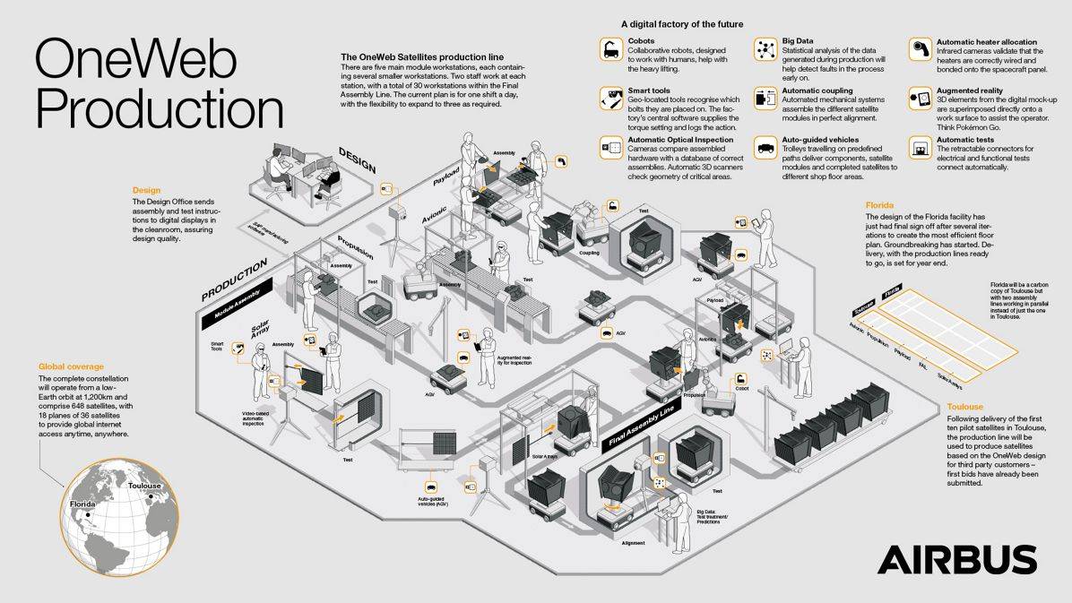
© Airbus
Notes:
OneWeb and the satellite production line - speaker notes
THE MAIN POINT: The picture is a satellite factory. Until about ten years ago satellites were hand-built one at a time. OneWeb changed that, and it is the reason satellite numbers exploded.
THE OLD WAY
Line to use: "A big telecoms satellite used to take three to five years to build and cost a couple of hundred million dollars - and every one was slightly different."
WHO ONEWEB ARE
Line to use: "OneWeb was set up in 2012 to bring broadband to places fibre will never reach - remote villages, ships, aircraft, oil rigs and disaster zones."
Background: The satellites fly at about 1,200km in near-polar paths, so they cover the whole world including the Arctic - something a fixed satellite over the equator cannot do.
THE FACTORY
Line to use: "Airbus and OneWeb built a factory in Florida that made around two satellites a day."
Background: Two parallel lines, each satellite about 150kg, moving from station to station like cars on an assembly line. Cost fell to well under a million dollars each - roughly a hundred times cheaper and a thousand times faster than the old way.
HOW YOU DO THAT
Line to use: "You freeze the design, keep the parts simple, let robots do the repetitive work, and buy components by the thousand."
Background: You also accept that the odd one will fail - if one in a hundred dies, you launch a replacement rather than spending years perfecting each unit. That is a big cultural change for the space industry.
THE BUMPS ALONG THE WAY
Line to use: "It nearly didn't survive."
Background: OneWeb ran out of money in March 2020 and was rescued by the UK Government and Bharti Global - which is how Britain came to own part of a satellite constellation. In 2022 the invasion of Ukraine stranded 36 satellites in Kazakhstan and ended its Russian launch contract overnight; it switched to American and Indian rockets and finished the job in 2023. It then merged with Eutelsat.
WHY IT MATTERS TO US
Production-line thinking is why satellite numbers have exploded, and SpaceX took the same idea even further. It also made CubeSats and amateur satellites affordable, because off-the-shelf parts and standard structures trickled down to universities and to us. The downside: mass production means mass disposal, which leads into the debris discussion.
TALKING POINT: Ask how long people think a satellite used to take to build - then say "two a day". Compare a hand-built Rolls-Royce with a car coming off a production line: same engineering, completely different thinking.

Slide 15
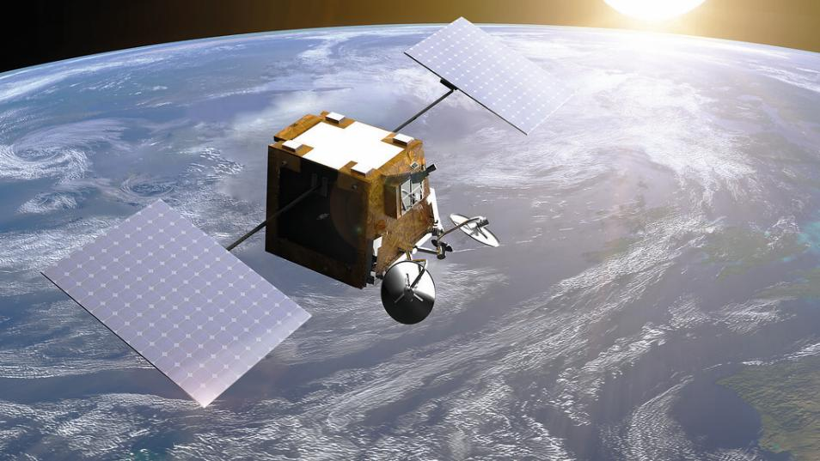
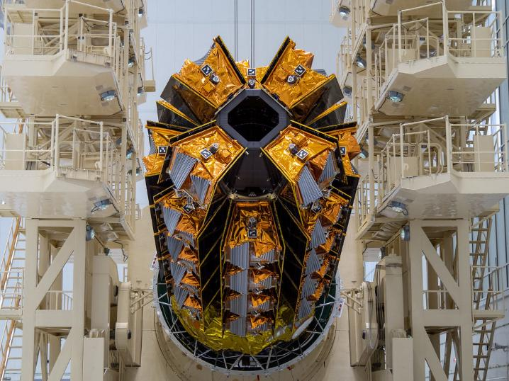
OneWeb
40
Gen 1 OneWeb Satellite
Images © Eutelsat
Version | Throughput per Satellite | Constellation Bandwidth
Gen 1 | Up to 7.2 Gbps | ~4.7 Tbps (648 sats × 7.2 Gbps) Actual
Gen 2 (planned) | ~20 Gbps (est.) | ~13 Tbps (648 sats × 20 Gbps) Proposed
Notes:
Constellation capacity - OneWeb Gen 1 and Gen 2 - speaker notes
THE MAIN POINT: The table shows how much data the OneWeb satellites can carry, and how much more the next generation should carry. The growth comes from better satellites, not more of them.
THE TABLE, IN PLAIN TERMS
Line to use: "Each of today's OneWeb satellites carries up to 7.2 gigabits per second. Across all 648 that is about 4.7 terabits - and that is real, flying hardware."
Background: The next generation is expected to manage about 20 gigabits each, which would take the same 648 satellites to roughly 13 terabits. Same number of satellites, nearly three times the capacity.
AN IMPORTANT CAVEAT
Line to use: "That total is not what any one user gets."
Background: A satellite is only overhead for a few minutes, and its capacity is shared by everyone below it. A busy city can use up all of it, while a ship in mid-Atlantic gets the lot to itself.
HOW STARLINK COMPARES
Line to use: "SpaceX took the same factory idea much further - it builds several satellites a day and launches them on its own rockets."
Background: Early Starlink satellites managed about 20 gigabits each; the newer ones are quoted at around 96 - roughly four times more. They also talk to each other by laser, so data can cross the constellation without coming down to the ground. With over 7,000 satellites in orbit, the total is in the hundreds of terabits.
THE TRADE-OFF BETWEEN THE TWO
Line to use: "It comes down to how high you fly."
Background: OneWeb flies high at 1,200km - fewer satellites needed, but slower response and it takes a long time for dead satellites to come down. Starlink flies low at 550km - faster response and they re-enter within about five years, but you need thousands and must keep replacing them. OneWeb sells through other companies; Starlink sells straight to the public.
TALKING POINTS
The interesting thing is not the speed but how fast it is growing - each generation roughly triples or quadruples capacity without the satellite getting any bigger. Then ask the audience: what does it mean for radio spectrum, for astronomy and for the night sky when tens of thousands are flying? That leads straight into the debris discussion.
Image credits: Eutelsat

Slide 16
Thank you for taking part in World Space Week 2026 and showing that amateur radio is part of space exploration, education and communication.
Don’t forget to:
Login via worldspaceweek.org/events and update your event listings with the number of people involved in your event
Share your results with RSGB Board Director Patrick Wood, 2E0IFB via 2e0ifb@rsgb.org.uk
All slides in this presentation are copyright of the RSGB 2026 and Patrick Wood, 2E0IFB

