Slide 1


The RSGB is supporting
World Space Week 2026!
Take inspiration from our ideas at rsgb.org/wsw and then start planning your event
4-10 October 2026
All slides in this presentation are copyright of the RSGB 2026 and Patrick Wood, 2E0IFB

Slide 2

World Space Week 2026

Slide 3
World Space Week 2026
General slides about the Space environment
"Here are a few ideas to help you put together a talk during World Space Week from 4-10 October 2026: pick and choose whatever works for you."

Slide 4
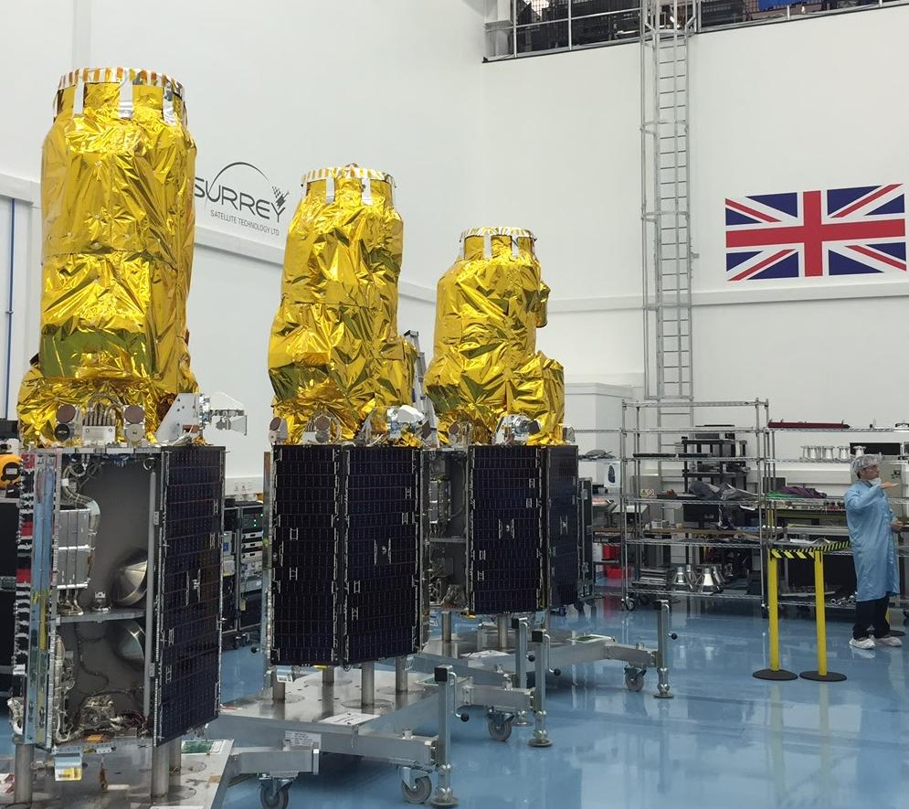
TITLE
Presenter
Image © SSTL
Notes:
TITLE SLIDE - the picture
WHAT IT SHOWS
Three Earth-imaging satellites called DMC3, built in Guildford, Surrey by a company called SSTL that began as a university spin-out.
SAY THIS
"These satellites were designed and built in Britain."
"They photograph the Earth in enough detail to see individual cars and buildings."
"They were built to help after disasters - floods, earthquakes and wildfires - by getting fresh pictures fast."
ONE EXTRA FACT IF ASKED
Launched in 2015. There are three of them spaced around the same orbit, so together they can photograph anywhere on Earth every day. The pictures are also used for mapping, farming and city planning.
LINK TO THE TALK
SSTL showed that useful satellites can be small, quick and affordable - the same idea that lets amateurs build satellites today.

Slide 5
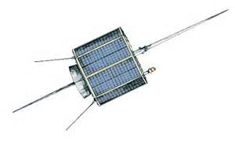
AO-07
145.850MHz
145.950MHz
432.175MHz
432.125MHz
Uplink
VHF
LSB / CW
UHF
LSB / CW
Non-Inverting Linear Transponder
Inverting
Linear Transponder
36cm
29.400MHz
29.500MHz
145.925MHz
145.975MHz
AO-07
Downlink
10m
USB /CW
VHF
USB / CW
UHF
2W
29.502MHz
8W PEP
145.970MHz
435.106MHz
Mode A
Mode A
Beacon CW
200mW
Mode B
Mode B
Beacon CW
200mW
Mode B Beacon CW
Altitude: 1450 km
Inclination: 101.59°
Speed: 7.2 km/s
Orbital Period: 114.9 minutes 12.5 rev/day
Launch mass: 28.6 kg
Power: ?.? watts
Launched: 15 Nov 1974
Launch vehicle: Delta 2310
Launch site: Vandenberg Air Force Base
AO-7 became non-operational in mid 1981 due to battery failure. In 2002 one of the shorted batteries became an open circuit and now the spacecraft is able to run off solar panels. For this reason, it is not usable in eclipse and may not be able to supply enough power to the transmitter to keep from frequency modulating the signal. When continuously illuminated, the mode will alternate between A and B every 24 hours.
Frequency: 2304.1 MHz was never turned on due to international treaty constraints.
Notes:
AO-7 - the oldest amateur satellite still working
THE STORY (the main point)
Built by volunteers from amateur radio groups in the USA, Germany, Australia and Canada. Launched November 1974. It stopped working in 1981 when a battery failed. In 2002 the faulty battery changed from short to open circuit and the satellite came back to life, running straight off its solar panels. It is still used today.
SAY THIS
"A 1974 satellite, the size of a suitcase, is still carrying amateur radio contacts fifty years later."
KEY FACTS
28.6 kg. Orbit 1,450 km high. Circles the Earth about every two hours.
No batteries, no ground control - it just runs on sunlight.
WHAT USERS NEED TO KNOW
- It only works in sunlight, and cuts out suddenly when it goes into the Earth's shadow.
- It switches itself between two modes (A and B) about every 24 hours, so listen for its beacon first to find out which is running.
- Use SSB or CW, never FM - one FM signal blocks everyone.
- Use low power. If you can hear yourself coming back, that is enough.
TALKING POINT
The best example of how long simple, robust engineering can last.

Slide 6
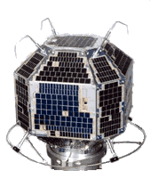
FO-29 Fuji-OSCAR-29, JAS-2
145.900MHz
146.000MHz
47cm
Uplink
VHF
LSB / CW
Inverting
Linear Transponder
435.900MHz
435.800MHz
Downlink
UHF
USB /CW
FO-29
435.910MHz
PSK digital
Digitalker
(Rarely used)
1W
435.795MHz
Altitude: 1300 km
Inclination: 98°
Speed: 7.2 km/s
Orbital Period: 112 minutes 13.5 rev/day
Launch mass: 50 kg
Power: ?.? watts
Launched: 17 Aug 1996
Launch vehicle: H-II
Launch site: TANEGASHIMA SPACE CENTER
(TNSTA), Japan
Beacon CW
12 WPM
100mW
For more information about FO-20 and 29 visit the Japan Amateur Radio League (English version) and the National Space Development Agency of Japan (English version) web pages.
Mineo Wakita, JE9PEL, has FO-29 satellite telemetry analysis programs. The software will automatically analyse all digital telemetry from the satellite such as current, voltage, and temperature. The software is available from http://www.ne.jp/asahi/hamradio/je9pel/
Notes:
FO-29 - Japan's amateur satellite
BACKGROUND
Built by the Japan Amateur Radio League and launched in August 1996 on a Japanese H-II rocket. About 50 kg, orbiting 1,300 km up.
SAY THIS
"This one was built and is still run by Japan's national amateur radio society."
"Because its orbit is high, passes last up to 20 minutes and you can reach right across Europe and beyond."
WHAT IS ON BOARD
A linear transponder (relays SSB and Morse signals), a Morse beacon, and - unusually - a voice unit that reads its own status aloud.
WHAT USERS NEED TO KNOW
- It is not always switched on. Its batteries are old, so the operators turn the transponder on and off. Check the AMSAT status page before a pass.
- Transmit on 2 m, listen on 70 cm.
- Keep power low - the satellite shares a small amount of transmit power among everyone using it.
TALKING POINT
A good example of how amateur satellites age gracefully: it still works, but power has to be rationed.

Slide 7
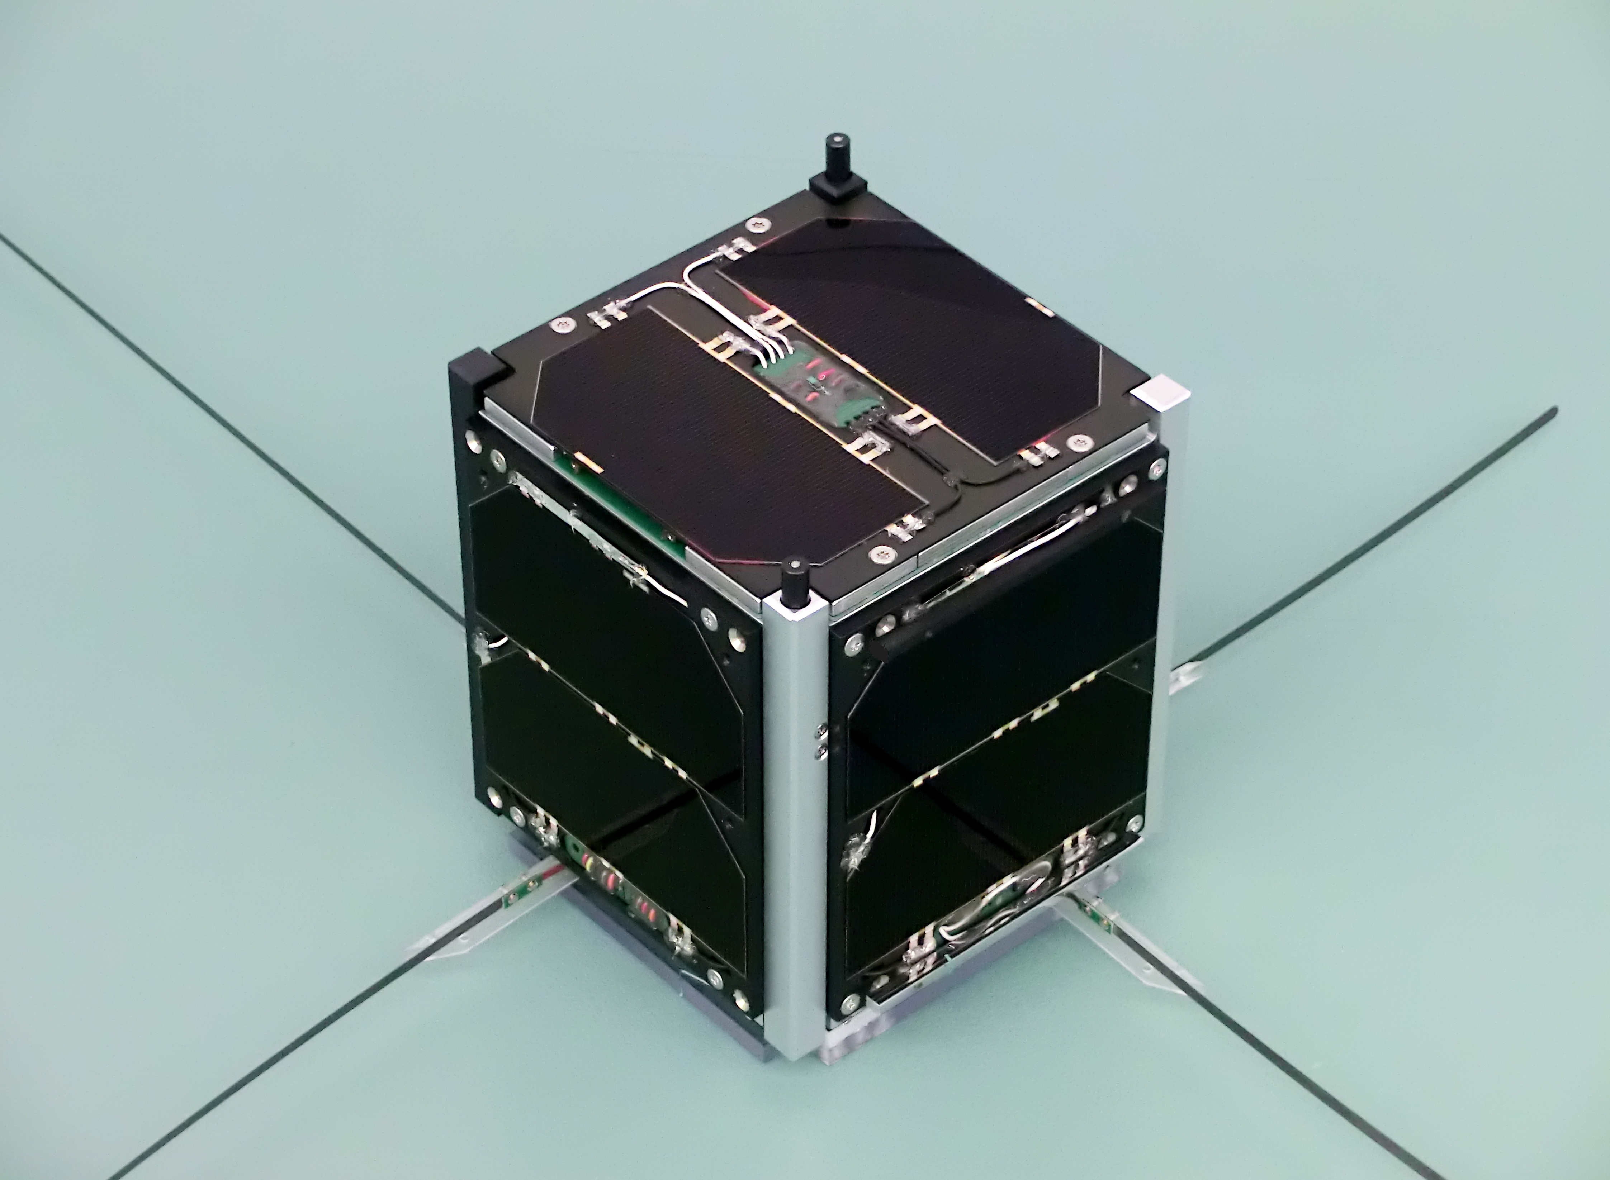
AO-73 FUNcube-1
10cm
435.150MHz
435.130MHz
UHF Uplink
LSB / CW
Inverting Linear Transponder
145.935MHz
145.950MHz
145.970MHz
VHF Downlink
USB / CW
AO-73 FUNcube-1 flight model © AMSAT-UK
Telemetry
1,200 bps BPSK FEC
30 or 300mW.
300mW
Altitude: 514 km to 567 km
Inclination: 97.8°
Speed: 7.59 km/s
Orbital Period: 95 minutes 15.1 rev/day
Launch mass: 0.98 kg
Power: 2.2 watts
Launched: 21 Nov 2013
Launch vehicle: Dnepr
Launch site: Yasny Launch Base, Orenburg, Russia
The passband may be up to 15 kHz higher depending on on-board temperatures. Low temperatures give higher frequencies.
FUNcube telemetry is received via radio amateurs who upload the data to the
FUNcube data warehouse:
https://funcube.org.uk/ground-segment/the-data-warehouse/
Operated by: AMSAT-NL with support from AMSAT-UK
1U CubeSat
Notes:
AO-73 FUNcube-1 - the education satellite
WHAT IT IS
A CubeSat: a 10 cm cube weighing under 1 kg, built by amateur radio volunteers in Britain and the Netherlands. Launched November 2013. It has only about 2 watts of power.
SAY THIS
"This whole satellite is smaller than a bag of sugar and was built by volunteers."
"It was designed so that schoolchildren could receive real data from space."
THE EDUCATIONAL BIT (the main point)
It broadcasts live information about itself - solar panel readings, temperatures, an experiment on board. Pupils receive it with a lower cost USB dongle and free software, and the data is uploaded automatically to a shared worldwide database.
WHAT USERS NEED TO KNOW
- It alternates between two modes: education mode (data beacon) and amateur mode (relaying contacts). If the relay seems missing, it is probably in education mode - not broken.
- Transmit on 70 cm, listen on 2 m. Very low power is plenty.
- Its frequencies drift slightly with temperature, so you may have to hunt for the signal.
TALKING POINT
Under a kilogram, two watts, built by volunteers - and doing real education since 2013. Anyone can receive it with very little kit.

Slide 8
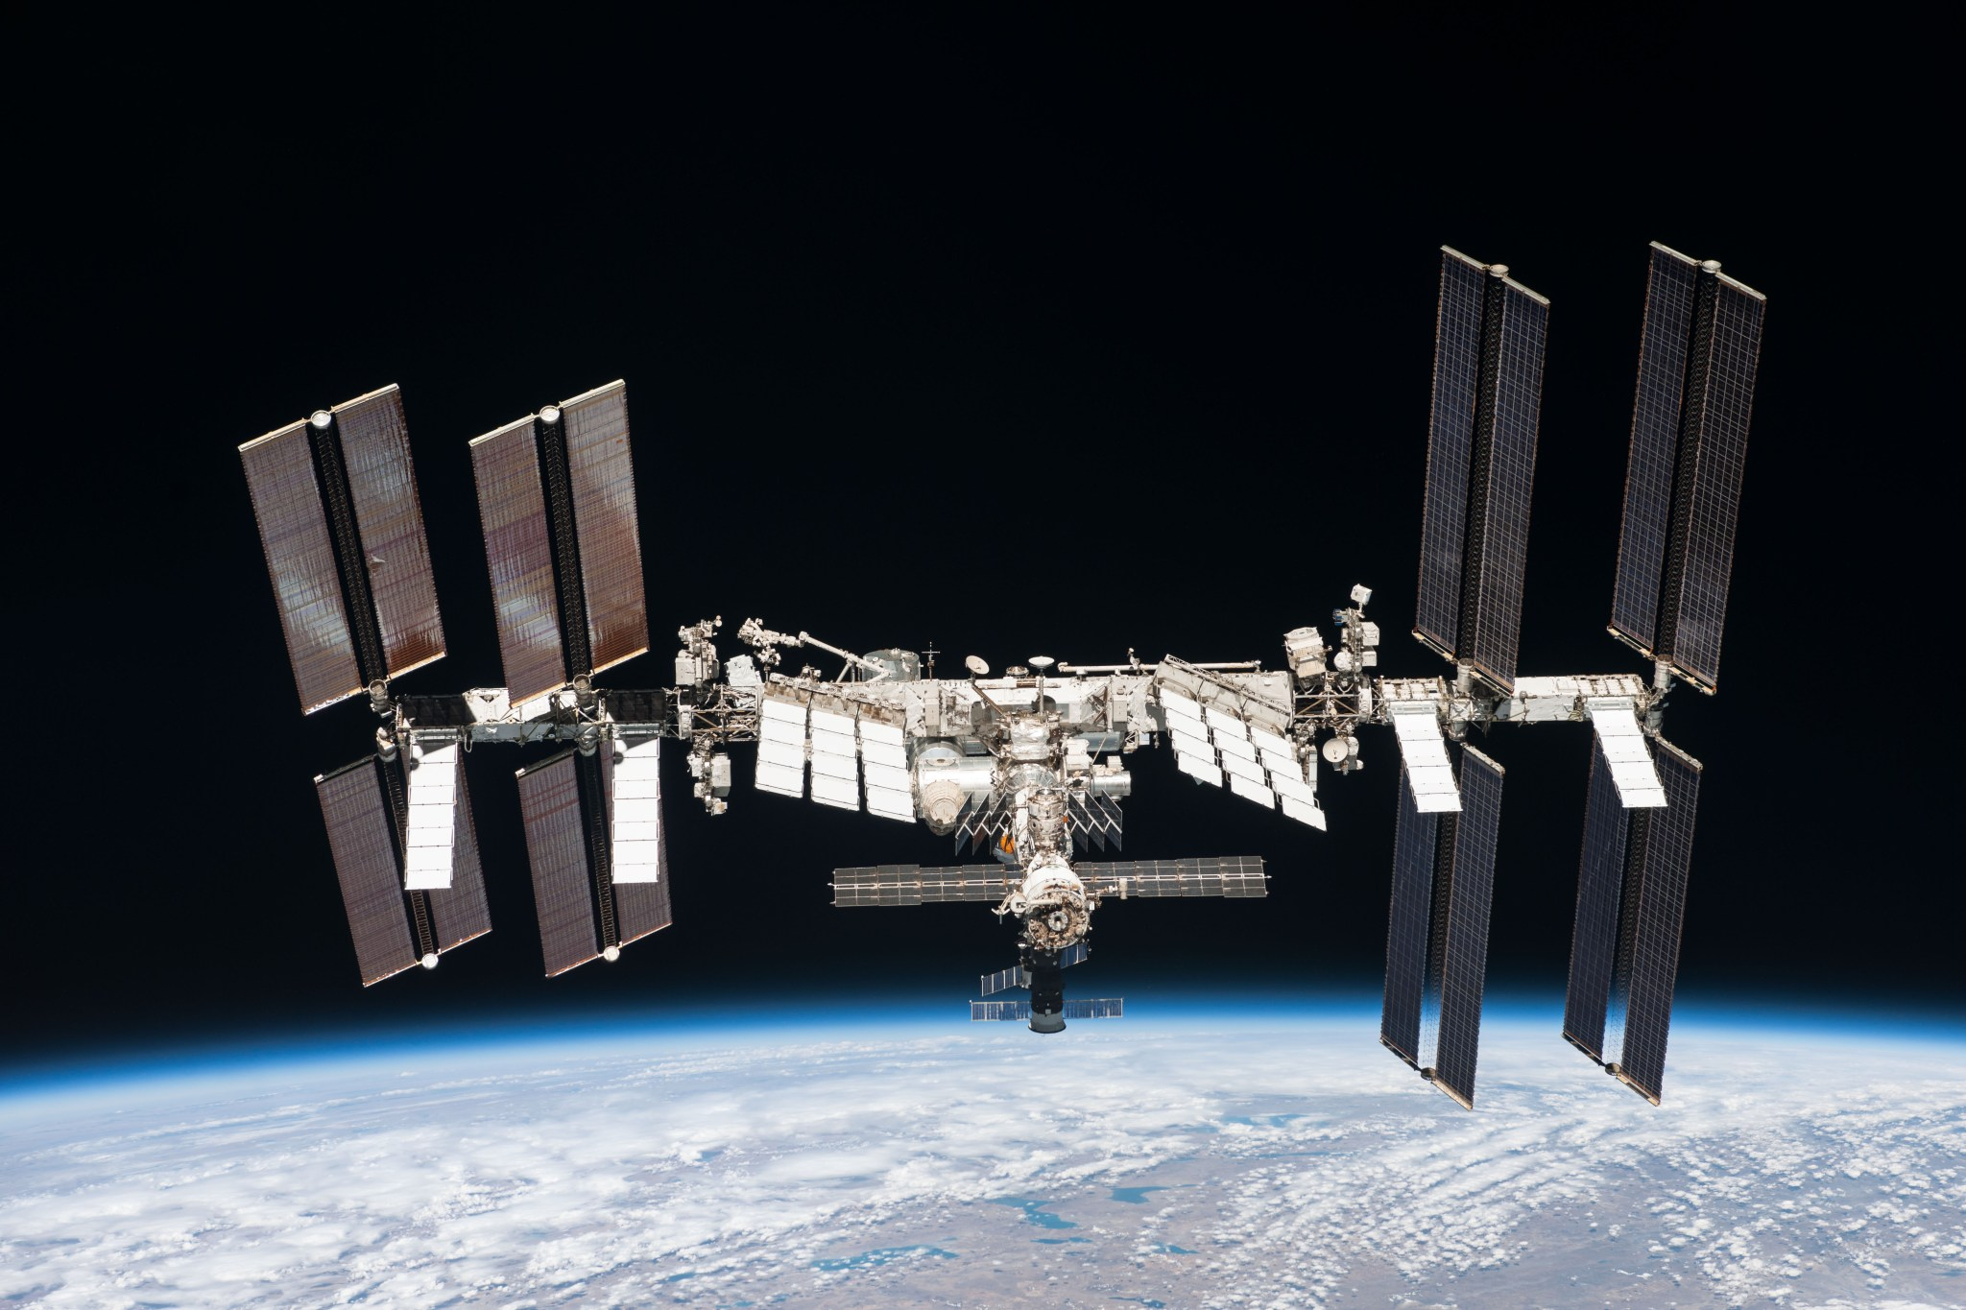
ISS
Region 1
Regions 2 & 3
109 m
145.200MHz
145.490MHz
145.825MHz
437.550Hz
145.990MHz
VHF
UHF
VHF
Uplinks
SSTV
(PD-120)
145.800MHz
145.825MHz
437.550Hz
437.800MHz
VHF
UHF
Downlinks
Crew Contact
FM Voice / SSTV
FM 1200bps
APRS
Digipeater
Worldwide
FM 1200bps
APRS
Digipeater
Worldwide
FM Voice
Repeater
Worldwide
International Space Station © NASA
Altitude: ~400km
Inclination: 51.6°
Speed: 7.67 km/s
Orbital Period: 90 - 93 minutes 15.5 rev/day
Mass: 419,725kg
Power: 75 – 90 kw
Notes:
The International Space Station - amateur radio on board
BACKGROUND
The biggest thing ever built in space - about 109 m across and 420 tonnes. Assembled in orbit from 1998 by the USA, Russia, Europe, Japan and Canada. It orbits 400 km up and goes round the Earth about every 90 minutes - 16 times a day.
WHO RUNS THE RADIO
A volunteer programme called ARISS, working with the space agencies. The radios on board are ordinary amateur Kenwood transceivers.
WHAT AMATEURS CAN DO (four things)
1. FM voice repeater - talk through the station to other amateurs.
2. APRS - send a short text/position message and see it relayed back.
3. Slow-scan TV - pictures sent down during special events; you need no transmitter at all, just an aerial and free software.
4. Crew contacts - scheduled question-and-answer sessions with schools. Listen only; don't transmit.
SAY THIS
"You can do this with a handheld radio and a homemade aerial."
PRACTICAL TIPS
Listen first, keep calls short - a pass lasts about ten minutes and everyone wants a turn.
TALKING POINT
This is the slide that wins an audience over: a handheld radio and a spacecraft the size of a football pitch passing overhead at 17,500 mph.

Slide 9
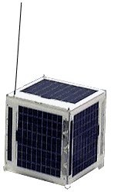
SO-50
(Saudi-OSCAR 50) SAUDISAT 1C
145.850MHz
67.0Hz CTCSS tone
VHF receiver with sensitivity of -124dBm, having an IF bandwidth of 15 kHz
20cm
VHF Uplink: FM
cross-band mode J FM repeater
436.795MHz
SO-50 © SaudiSat 1C
UHF Downlink: FM
Altitude: 568 km to 671 km
Inclination: 64.5°
Speed: 7.6 km/s
Orbital Period: 97 minutes 14.8 rev/day
Launch mass: 15 kg 8U CubeSat
Power: ? watts
Launched: 20 Dec 2002
Launch vehicle: Dnepr. 4,500kg to LEO
Launch site: Baikonur, Kazakhstan
250mW
Timer Activation: SO-50 has a 10-minute timer for the repeater.
To activate, transmit a 2-second carrier with a PL tone of 74.4 Hz before using the repeater.
Operated by: King Abdulaziz University for Science & Technology
Notes:
SO-50 - the best satellite for beginners
BACKGROUND
Built in Saudi Arabia by the national science and technology institute, launched December 2002. About 15 kg, orbiting roughly 600 km up. Still working after more than twenty years.
WHY IT MATTERS
It carries a simple FM repeater, so an ordinary dual-band handheld radio and a small hand-held aerial are enough to make a contact through it.
SAY THIS
"If you already own a dual-band handheld, you already own most of what you need to talk through a satellite."
THE ONE ODD DETAIL
The repeater is not always on. It has a ten-minute timer. You switch it on by sending a two-second carrier with a 74.4 Hz tone - a different tone from the one used for normal access. Usually someone else does this at the start of a pass, so listen first.
PRACTICAL TIPS
- FM means only one person at a time. Listen, call briefly with your callsign, swap callsign and location, then make way.
- Its transmitter is tiny (a quarter of a watt), so a simple directional aerial makes a huge difference.
TALKING POINT
The classic starter satellite.

Slide 10
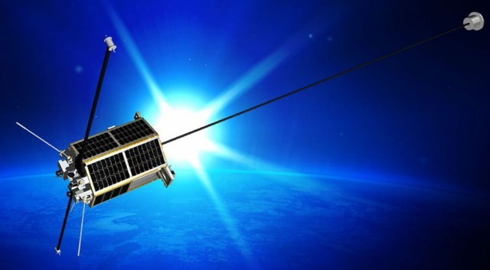
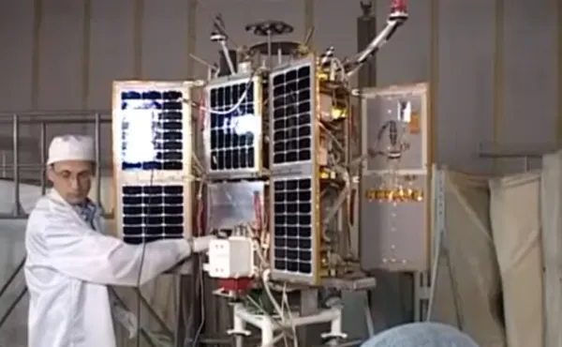
RS-44 DOSAAF-5, Radio-2017
60kHz passband
145.995MHz
145.935MHz
VHF Uplink
LSB / CW
Inverting Linear Transponder
435.605MHz
435.610MHz
435.670MHz
~70cm
UHF Downlink
USB / CW
RS-44 satellite ( & in build/test )
CW Beacon
Sends “RS44” every 10secs
5W
Altitude: 1175km to 1511km
Inclination: 82.5°
Speed: 7.16 km/s
Orbital Period: 112 minutes 12.8 rev/day
Launch mass: ~100kg kg
Power: ?? watts
Launched: 26 Dec 2019
Launch vehicle: Rokot 1,200kg to LEO
Launch site: Plesetsk, Russia
The satellite is still attached to the upper stage of the launch vehicle, so the gravity boom never deployed.
Notes:
RS-44 - long passes and plenty of range
BACKGROUND
A Russian amateur payload launched December 2019, sharing a rocket with a navigation satellite. About 100 kg, in a high orbit between 1,175 and 1,500 km.
THE QUIRK (worth mentioning)
It never separated from the rocket's upper stage, so its stabilising boom never deployed. The satellite tumbles slowly, which makes the signal fade in and out.
SAY THIS
"Because its orbit is high, passes last over twenty minutes and you can work most of Europe, North Africa and the Middle East - sometimes across the Atlantic."
WHAT USERS NEED TO KNOW
- The signal rises and fades every few tens of seconds because of the tumble. Don't assume you have lost it - wait.
- Transmit on 2 m, listen on 70 cm. Use SSB or Morse, never FM.
- It has a wide relay bandwidth, so spread out rather than all crowding the middle.
- Listening to your own signal coming back is the key skill.
TALKING POINT
The natural next step after the simple FM satellites.

Slide 11
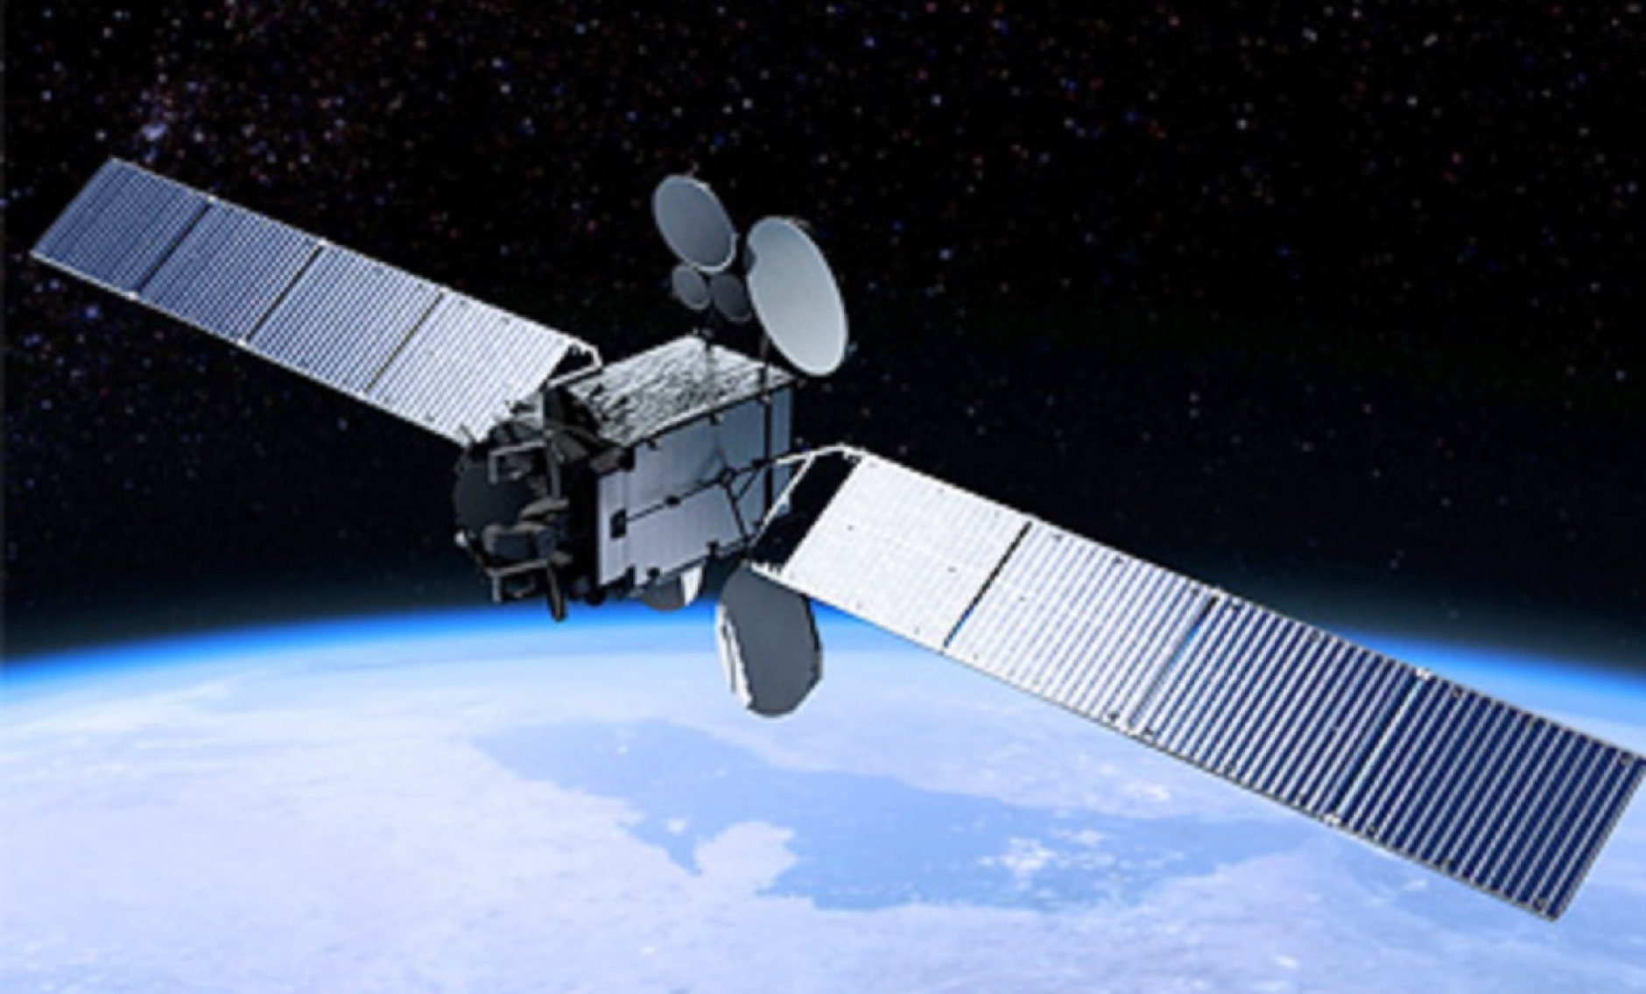
Es'hail 2 Satellite
QO-100
Span ~30m
Es'hail 2 satellite was built by Mitsubishi Electric company (MELCO) in Japan
GEO satellite located at 26° East
Direct-to-home television services for the Middle East and North Africa region
24 Ku-band and 11 Ka-band transponders
Radio Amateur Payload – AMSAT-DL
  Uplink on 2.4 GHz (13-cm band) and downlink on 10.45 GHz (3-cm band).
  Linear transponder with a bandwidth of 500 kHz (NB Transponder)
  and 8 MHz transponder (WB Transponder)
Altitude: 35,786 km
Inclination: 0.0°
Speed: 3.07 km/s
Orbital Period: 24 hours 1 rev/day
Central structure ~ 2.8m x ~2.8m x ~4m (height)
Launch mass 5,300 kg
Operational life 15+ years
Power 15kW
Launched 15 Nov 2018
Launch Vehicle Falcon 9 Block 5
Launch site Cape Canaveral SFS
Notes:
QO-100 - the satellite that never moves
WHY IT IS SPECIAL (the main point)
It is the first amateur radio relay in geostationary orbit. Every other satellite in this talk races overhead for ten or twenty minutes. This one sits still in the sky, is available 24 hours a day, and covers about a third of the planet - from Brazil to Thailand.
BACKGROUND
The host satellite, Es'hail-2, is a large commercial TV satellite built by Mitsubishi Electric in Japan, launched on a SpaceX Falcon 9 in November 2018. It is owned by Es'hailSat of Qatar and mainly carries television for the Middle East and North Africa. The amateur equipment on board was designed and built by AMSAT-DL in Germany.
KEY FACTS
35,786 km up. 5,300 kg. 15 kW of power. Around 30 m across with its solar panels out.
WHAT AMATEURS GET
Two relays: a narrow one for voice and Morse, and a wide one for amateur television. Uplink 2.4 GHz, downlink 10.45 GHz.
WHAT USERS NEED TO KNOW
- No tracking needed: a small satellite TV dish, aimed once and left alone.
- A few watts into a 1 m dish is a normal station.
- The golden rule: never transmit stronger than the satellite's own marker beacon. Too much power steals capacity from everyone.
- You can listen online first, through web-based receivers, before buying anything.
TALKING POINT
Guaranteed to work at 2pm on a Tuesday - ideal for demonstrations and school events.

Slide 12
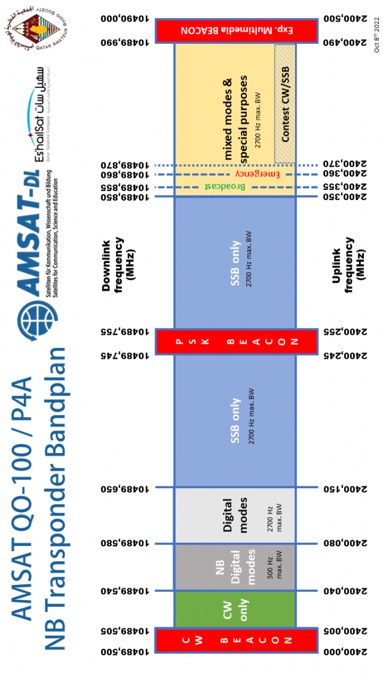
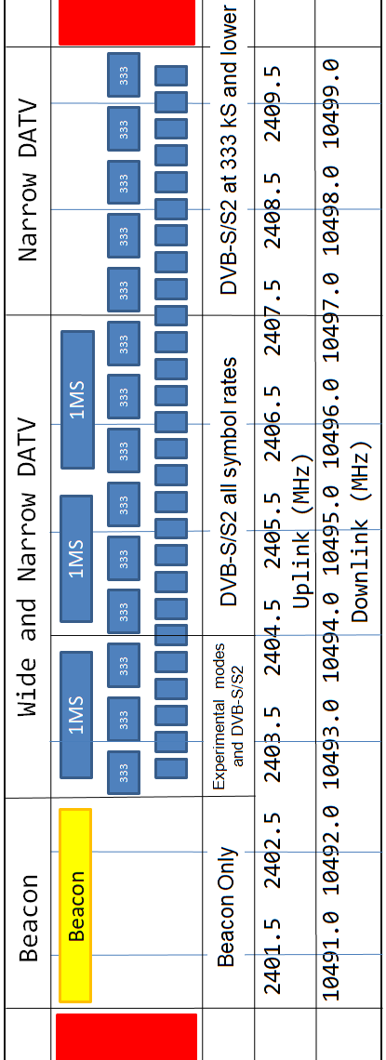
WB Transponder Bandplan

Slide 13
Thank you for taking part in World Space Week 2026 and showing that amateur radio is part of space exploration, education and communication.
Don’t forget to:
Login via worldspaceweek.org/events and update your event listings with the number of people involved in your event
Share your results with RSGB Board Director Patrick Wood, 2E0IFB via 2e0ifb@rsgb.org.uk
All slides in this presentation are copyright of the RSGB 2026 and Patrick Wood, 2E0IFB

