Slide 1


The RSGB is supporting
World Space Week 2026!
Take inspiration from our ideas at rsgb.org/wsw and then start planning your event
4-10 October 2026
All slides in this presentation are copyright of the RSGB 2026 and Patrick Wood, 2E0IFB

Slide 2
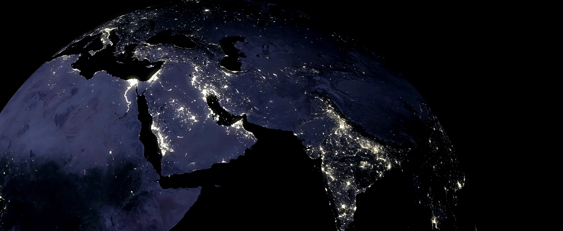
World Space Week 2026

Slide 3
World Space Week 2026
General slides about the Space orbits
"Here are a few ideas to help you put together a talk during World Space Week from 4-10 October 2026: pick and choose whatever works for you."

Slide 4
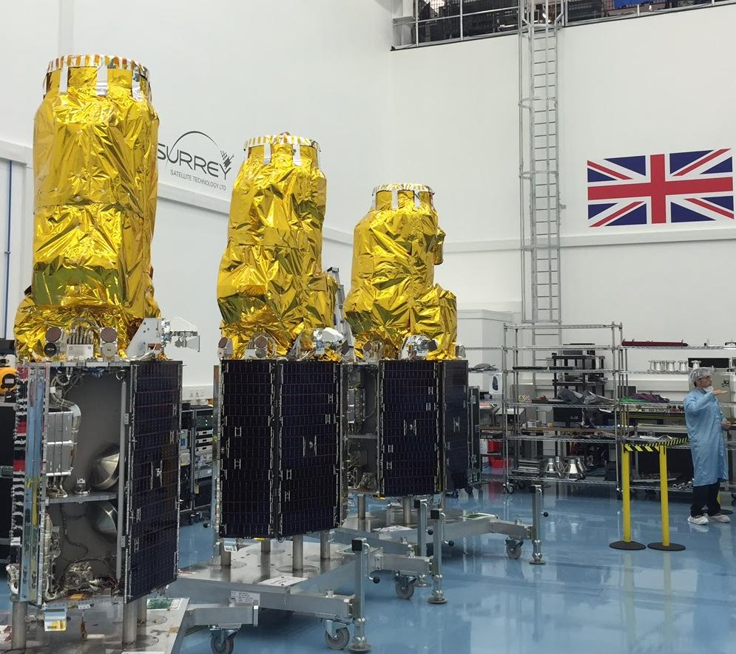
TITLE
Presenter
Image © SSTL
Notes:
TITLE SLIDE - the picture
WHAT IT SHOWS
Three British-built Earth-imaging satellites (SSTL's DMC3, launched 2015).
SAY THIS
- "These satellites were designed and built in Britain, by a company that began as a university spin-out."
- "They photograph the Earth in enough detail to see cars and buildings."
- "They were built to help after disasters - floods, earthquakes, wildfires - by getting fresh pictures fast."
IF ASKED
- 1 metre detail in black and white, 4 metres in colour.
- Three satellites spaced round the same orbit, so anywhere on Earth can be imaged daily.
- Images also used for mapping, farming and city planning.
WHY IT MATTERS
SSTL showed satellites can be small, quick and affordable - the thinking behind today's amateur-built satellites.

Slide 5

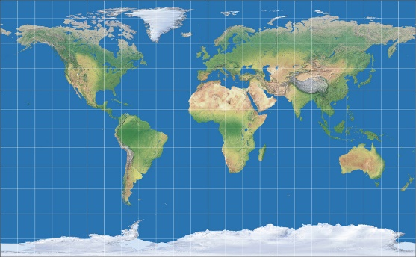
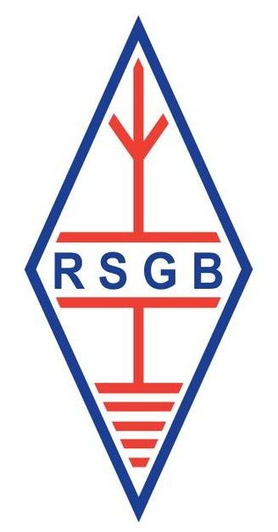
Orbital Mechanics 101
animation
HEO Highly Elliptical Orbit
Example Northern Hemisphere
telecommunications
12-hour orbit
~ 26,000km
CLICK MOUSE ONCE TO fade other sats & show eclipse effect on GEO Sats
CLICK MOUSE ONCE TO START ANIMATION
CLICK MOUSE ONCE TO SHOW MEO SATS
CLICK MOUSE ONCE TO SHOW HEO SATS
CLICK MOUSE ONCE TO SHOW GEO SATS
GEO Stationary Orbit
Example telecommunications
24-hour orbit
35,786km
MEO Medium Earth Orbit
Example – Satnav constellation
8-to-12-hour orbit
~ 20,000km
MEO Satellites
Typically used for navigation systems, like Galileo, Europe’s Navigation system, 24 satellites + 6 spares in 3 orbital planes. Animation shows 3 sats per plane, an observer can always see multiple sats, giving more accurate positioning
GEO Satellites
Used for global communications, the animation shows 3 satellites at 120 degrees apart giving the ability for global coverage but not so good for comms to the poles.
HEO Satellites
An unusual orbit, typically used for communication, this example is for northern hemisphere comms, and typically several satellites are used so 1 is always above the horizon
LEO Satellites:
Used for communication, Earth Observation, Scientific satellites observing the Earth and Space Stations like the ISS.
GEO Satellites
Feb to April, & Sept to Oct.
GEO orbits are in eclipse for up to ~ 70 mins, once per day.
LEO Low Earth Orbit
Example – Imaging satellites
100-minute orbit
~ 550km – 1,550km
SES
© Patrick Wood. 2E0IFB.
5
Notes:
ORBITAL MECHANICS 101 - animated slide, click by click
HOW IT WORKS
One diagram: Earth in the middle, Sun to the side, four orbit types. Each mouse click adds one type. Let the animation run a few seconds before you talk. The on-screen "CLICK MOUSE" prompts are your cues.
CLICK 1 - LEO (low Earth orbit)
550-1,550km up, one lap every 100 minutes (16 a day). Used for comms, Earth imaging, science, the ISS.
Say: "Notice how fast they move - a pass over your radio only lasts about ten minutes."
CLICK 2 - MEO (medium)
About 20,000km, 8-12 hours per lap. Satnav lives here - Galileo has 24 satellites plus 6 spares.
Say: "You can always see several at once, and that's what makes your position accurate. Higher = slower."
CLICK 3 - HEO (stretched oval)
12-hour orbit out to about 26,000km.
Say: "It races past when close and crawls when far away, so it hangs for hours over the northern half of the world - exactly where geostationary satellites are weak."
CLICK 4 - GEO (geostationary)
35,786km, one lap per day.
Say: "They turn at the same speed as the Earth, so they seem to hang still - your dish never has to move." Three of them cover nearly the whole globe, but not the poles. Used for TV and telecoms.
CLICK 5 - ECLIPSE
Other orbits fade; Earth's shadow crosses the GEO ring.
Say: "Around spring and autumn, a GEO satellite passes through Earth's shadow once a day for up to 70 minutes - no sunlight, so it runs on batteries."
ONE MESSAGE TO END ON
The higher you go, the slower it moves and the longer you can see it - but the weaker the signal and the longer the delay.
HOUSEKEEPING
Animation © Patrick Wood, 2E0IFB. It only runs in presentation mode, and it advances on clicks.

Slide 6
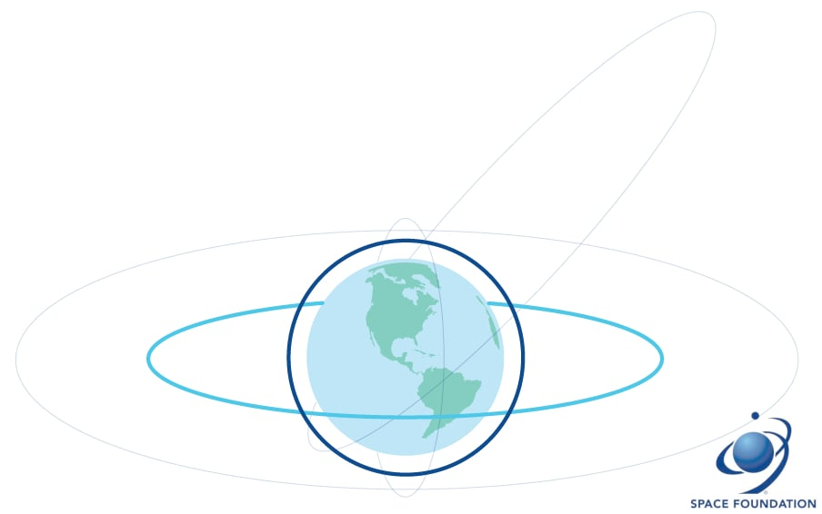
Low & Medium Earth Orbits
Low Earth Orbit (LEO)
Up to 2,000km; orbit takes 92 to 127 minutes
Used for comms, remote sensing, the ISS and Hubble
Medium Earth Orbit (MEO)
2,000km up to GEO; about 12 hours at 20,000km
Used for navigation - GPS and Galileo - and now comms
Orbital diagrams from the Space Foundation, a nonprofit organisation founded in 1983 as a gateway to advance the global space community.
Notes:
LOW & MEDIUM EARTH ORBITS
LEO - up to 2,000km
- The ISS at 400km goes round in about 92 minutes - the crew see 16 sunrises a day.
- Used for comms, weather and Earth imaging, Hubble, the ISS, and most amateur satellites.
- Close = strong signal, so a handheld radio can work them. But a pass lasts only 10-15 minutes and you must track it and allow for Doppler shift.
MEO - 2,000km up to 35,786km
- A typical satnav orbit at 20,000km takes about 12 hours per lap, so it drifts slowly across the sky and few satellites cover the world.
- Used by GPS and Galileo (24 satellites plus 6 spares, in three planes), and now some broadband systems.
TALKING POINTS
- The trade-off: lower = stronger signal but shorter pass and more satellites needed.
- Ask: "Who used satnav today without thinking about a spacecraft 20,000km up?"
- Leads into the amateur satellite, ISS and QO-100 slides later.
CREDIT: diagrams from the Space Foundation.

Slide 7
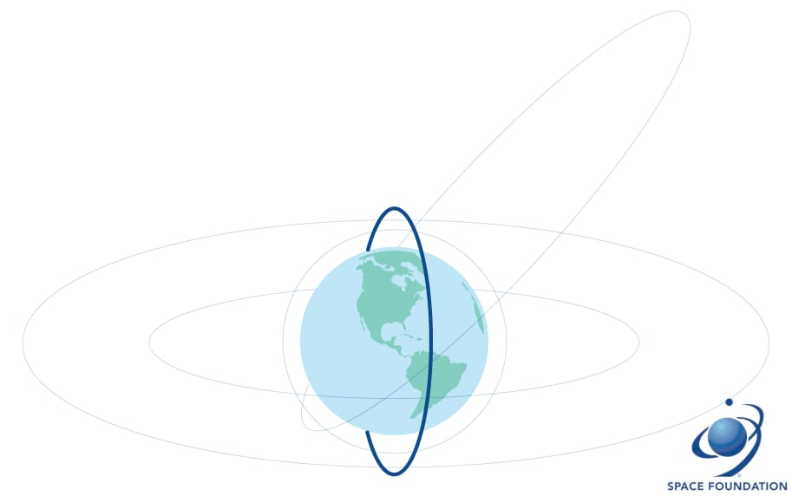
Specific types of LEO orbit
Polar Orbit
Within 30 degrees of the poles - reconnaissance, weather and Earth observation
Sun-Synchronous Orbit (SSO)
A polar orbit at 97-99 deg inclination; passes over the same place at the same local time
International Space Station
Inclined 51.6 deg, so it reaches 51.6 deg north and south
From the NRC at 52 deg north the ISS peaks at about 86 deg elevation
Notes:
SPECIFIC TYPES OF LEO ORBIT
POLAR ORBIT
Goes nearly over both poles, so as the Earth spins underneath it eventually sees everywhere. Used for weather, Earth observation and reconnaissance. Costs more fuel to launch, because you get no free push from the Earth's spin.
SUN-SYNCHRONOUS (SSO)
A polar orbit tilted 97-99 degrees, arranged so the satellite passes over any place at the same local time every day. That means the lighting in the pictures is always the same, which makes images comparable over years. Most weather and imaging satellites use it.
THE ISS
Tilted 51.6 degrees - a compromise so both Russian and US launch sites can reach it. So it only flies over places up to about 51.6 degrees north and south, which still covers most of the world's people.
WHAT THAT MEANS HERE
Bletchley Park is at 52 degrees north - just outside that band. So the ISS never passes exactly overhead; the best pass reaches about 86 degrees, which is near enough overhead in practice.
TALKING POINTS
- The tilt of the orbit decides who on Earth can hear the satellite.
- Pass-prediction software uses exactly these numbers.

Slide 8
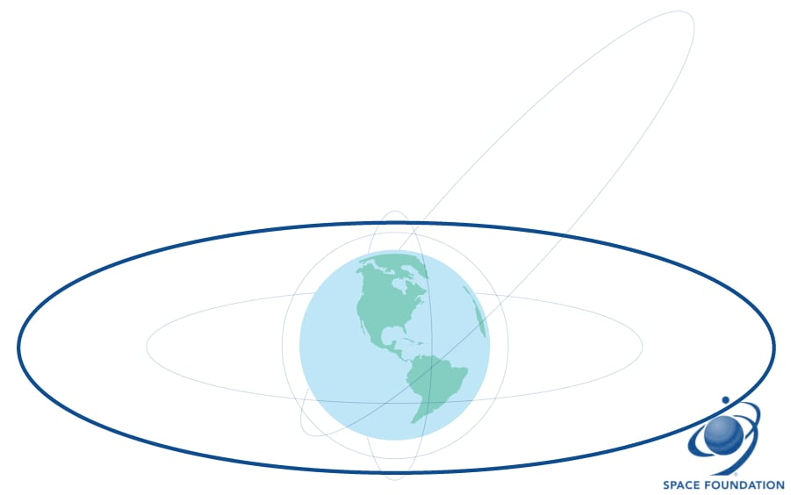
Geosynchronous Orbit
Geosynchronous (GSO) and Geostationary (GEO)
35,786km up, one orbit every 24 hours
GSO matches the Earth's rotation; GEO does it over the equator
From the ground a GEO satellite appears fixed in the sky
Used for telecommunications and Earth observation
Notes:
GEOSYNCHRONOUS & GEOSTATIONARY
THE BASICS
35,786km up, one orbit per day - so the satellite keeps step with the spinning Earth.
THE DIFFERENCE (simple version)
- Geosynchronous (GSO): takes a day to go round, but if it's tilted it wanders in a figure-of-eight in the sky.
- Geostationary (GEO): the special case sitting right over the equator - it appears to stand completely still.
WHY IT'S USEFUL
Fixed position means a fixed dish: no tracking, no Doppler, always available. That's why it carries TV, telephone links and weather imagers. Three satellites cover almost the whole populated world.
THE DOWNSIDES
- Signals take about half a second there and back - the delay you hear on satellite phone calls.
- Much weaker signal, so you need a dish, not a whip aerial.
- Poor coverage near the poles.
- Slots over the equator are limited and internationally allocated.
LINK AHEAD
This sets up QO-100 - the first geostationary satellite with an amateur radio payload, giving all-day access from a fixed dish.

Slide 9
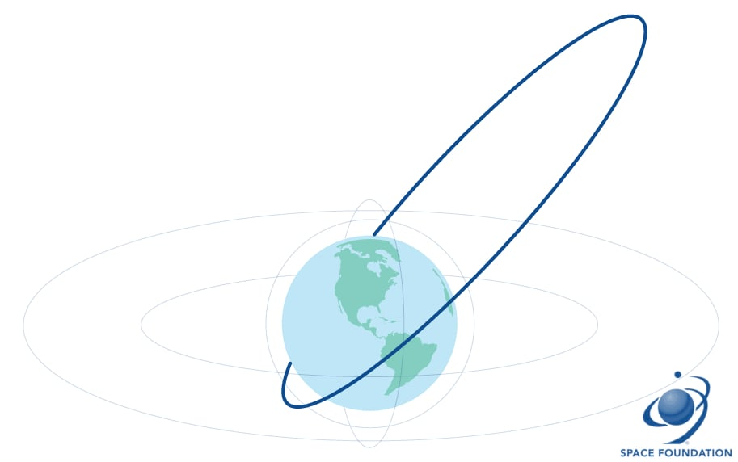
Highly Elliptical Orbit (HEO)
Highly Elliptical Orbit (HEO)
An oblong orbit - one end close to Earth, the other far out
Slow and high over one region, fast at perigee
Good for high-latitude communications, satellite radio and remote sensing
Notes:
HIGHLY ELLIPTICAL ORBIT (HEO)
THE SHAPE
A stretched oval: a low point a few hundred km up and a high point 40,000km or more out.
THE KEY IDEA
It moves fastest when close and slowest when far away - so it spends most of each orbit hanging high over one part of the world.
WHY USE IT
It gives geostationary-like coverage of high latitudes, where a GEO satellite sits too low in the sky. The classic example is the Molniya orbit (12 hours, tilted 63.4 degrees); two or three satellites give the far north continuous coverage. Also used for satellite radio and space science.
THE AMATEUR ANGLE
Amateur satellites AO-10, AO-13 and AO-40 used these orbits - hours of intercontinental contacts instead of a ten-minute LEO pass. The cost: you must track it, and signal strength changes hugely through the pass.
TALKING POINT
LEO, GEO and HEO are three answers to one question: how do you keep a satellite where you need it, and what will you pay in energy, tracking and delay?

Slide 10
Launching a satellite into a Low Earth Orbit
Once in orbit, typical times for a satellite to decay from orbit.
11.2 km/s Earth’s Escape velocity
Spacecraft separation typically around 10 mins after launch (LEO mission)
Typical orbit lifetime for a large satellite
Altitude (km) | Estimated decay time
100 | 2 hours
200 | 1 week
500 | 2 years
600 | 20 years
800 | 200 years
Earth
12,756 km
600 km
12,714 km
7.56 km/s
97 minute orbit
© Wikipedia
600km orbit
Notes:
LAUNCHING A SATELLITE INTO LOW EARTH ORBIT
THE BIG IDEA
Getting up there is easy; staying there is hard. Height alone is not orbit. You need enough sideways speed that as you fall, the Earth curves away beneath you - you're falling forever and always missing. That's why a rocket tips over early and spends most of its energy going sideways, not up.
THE NUMBERS ON THE DIAGRAM
- 600km orbit needs about 7.56 km/s - roughly 27,000 km/h.
- One lap takes about 97 minutes.
- Earth is about 12,750km across, so 600km is only a thin skin above the surface.
- The satellite separates from the rocket around 10 minutes after lift-off.
THE SPEED WINDOW
- Too slow: it arcs back down and re-enters.
- Just right: it orbits.
- Too fast (about 10.7 km/s here): it escapes Earth altogether.
Right speed, right direction, right height - all at once.
DIRECTION MATTERS TOO
Launching eastwards gets a free 0.46 km/s from the Earth's spin - hence equatorial launch sites. Polar and sun-synchronous orbits give that up and cost more. The tilt is fixed at launch; changing it later is very expensive.
AND THE AIR
Even at 600km there's a trace of atmosphere, so orbits slowly decay - see the table: 200km lasts a week, 600km about 20 years, 800km about 200 years.
TALKING POINTS
- Newton's cannonball: fire it hard enough and it never lands.
- Ask the audience to guess the orbital speed before revealing 7.56 km/s.
- Diagrams credited to Wikipedia and Ham Radio School.

Slide 11
Thank you for taking part in World Space Week 2026 and showing that amateur radio is part of space exploration, education and communication.
Don’t forget to:
Login via worldspaceweek.org/events and update your event listings with the number of people involved in your event
Share your results with RSGB Board Director Patrick Wood, 2E0IFB via 2e0ifb@rsgb.org.uk
All slides in this presentation are copyright of the RSGB 2026 and Patrick Wood, 2E0IFB

